Slide 1
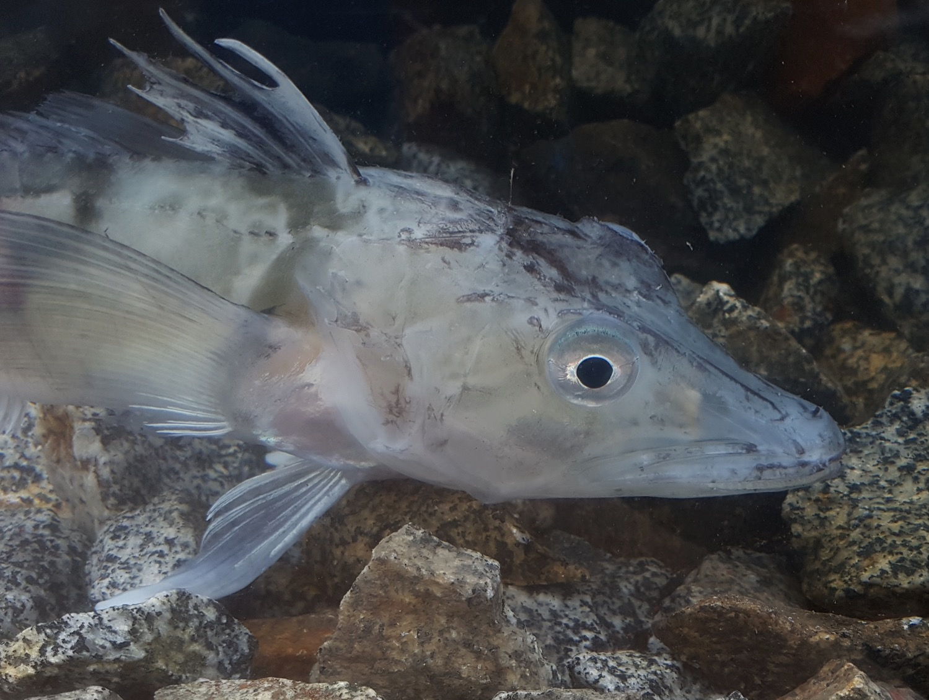
How Will Antarctic Fishes Fare as the Southern Ocean Warms?
Ocellated icefish, Chionodraco rastrospinosus
Kristin O’Brien
Associate Professor of Biology & Wildlife
Institute of Arctic Biology
Photo credit: Michael Axelsson

Slide 2
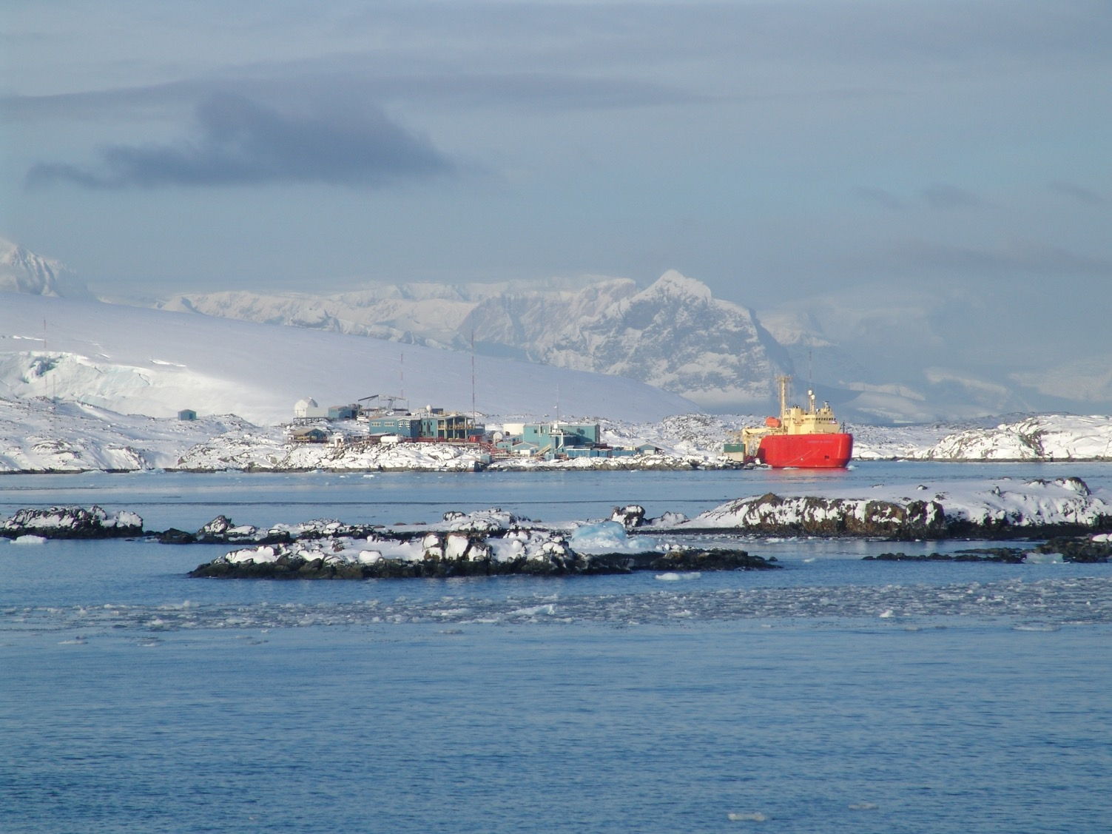

Slide 3
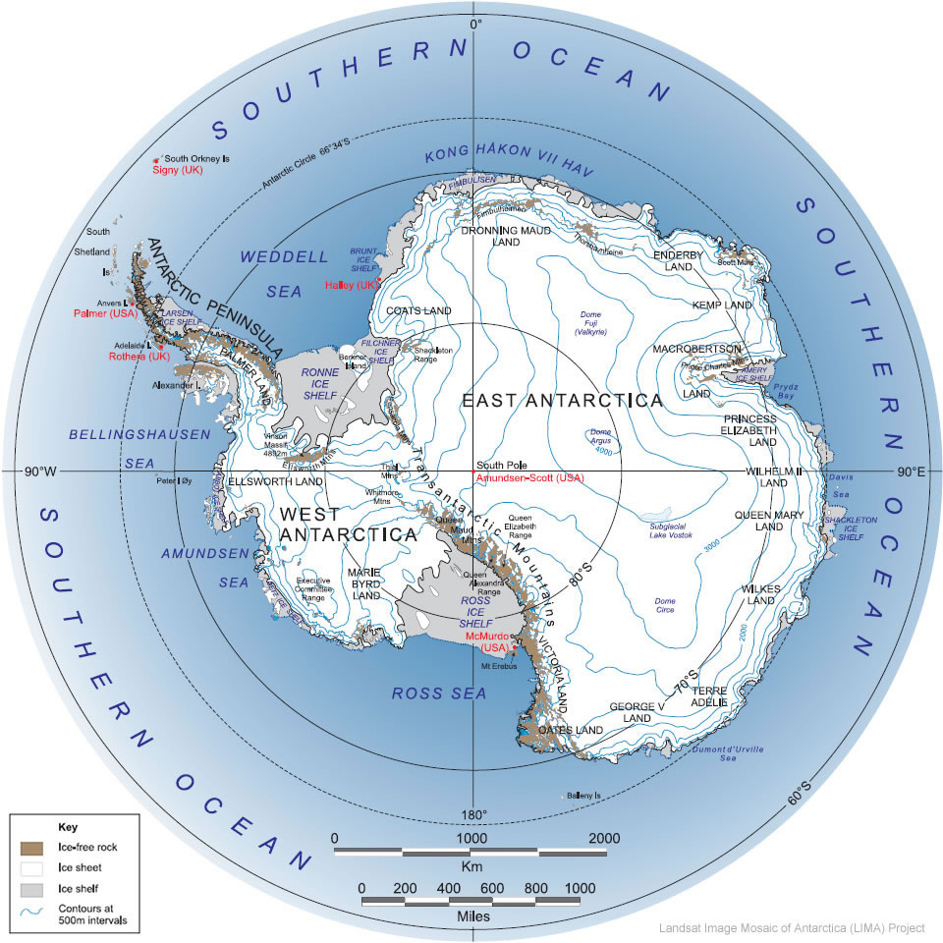

Slide 4
How Will Antarctic Fishes Fare as the Southern Ocean Warms?
Ocellated icefish, Chionodraco rastrospinosus
Kristin O’Brien
Associate Professor of Biology & Wildlife
Institute of Arctic Biology
Photo credit: Michael Axelsson

Slide 5
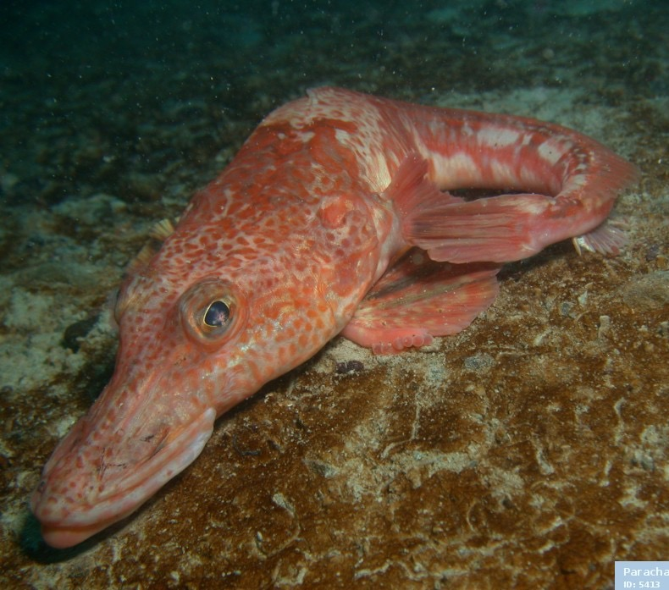
Dragonfish, Parachaenichthys charcoti

Slide 6
Bald rockcod, Pagothnia borchgrevinki
Photo credit: I.R. MacDonald

Slide 7
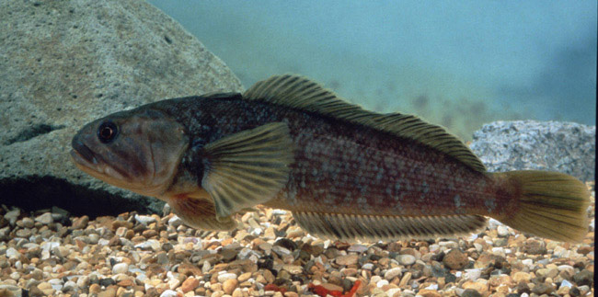
Yellowbelly rockcod, Notothenia coriiceps

Slide 8
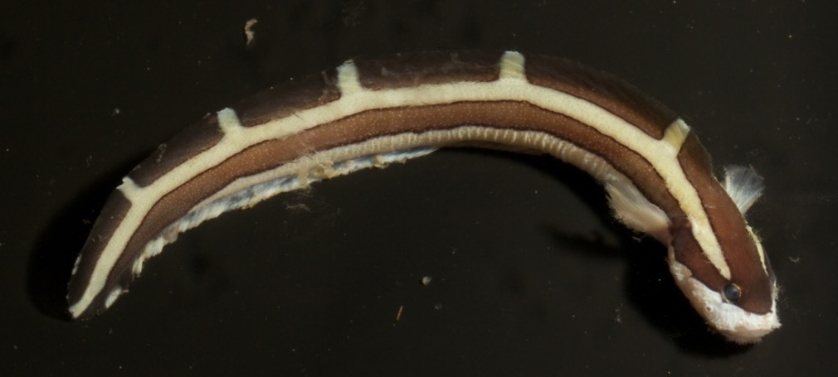
Antarctic Eelpout

Slide 9
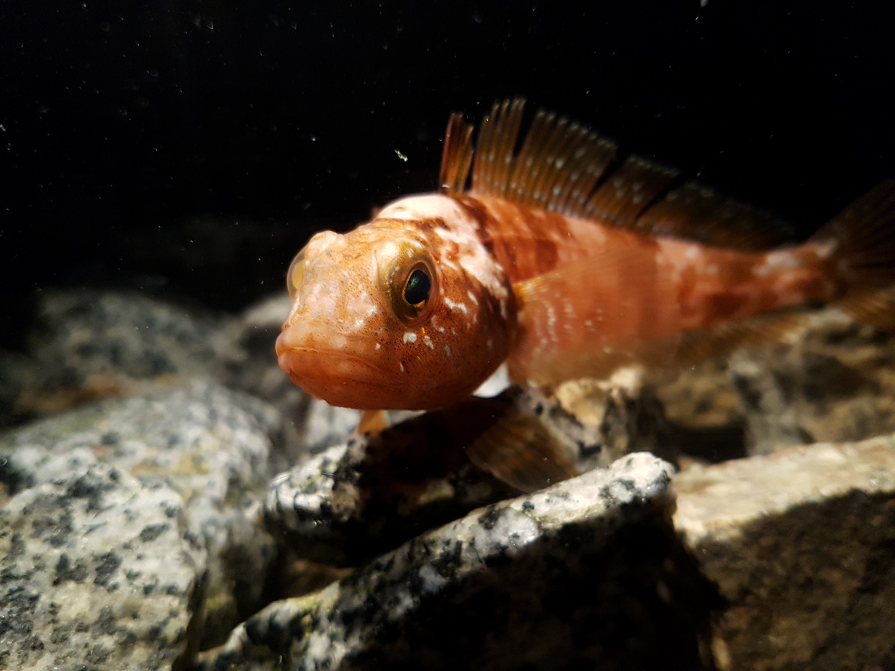
Emerald rockcod, Trematomus bernacchii
Photo credit: Michael Axelsson

Slide 10
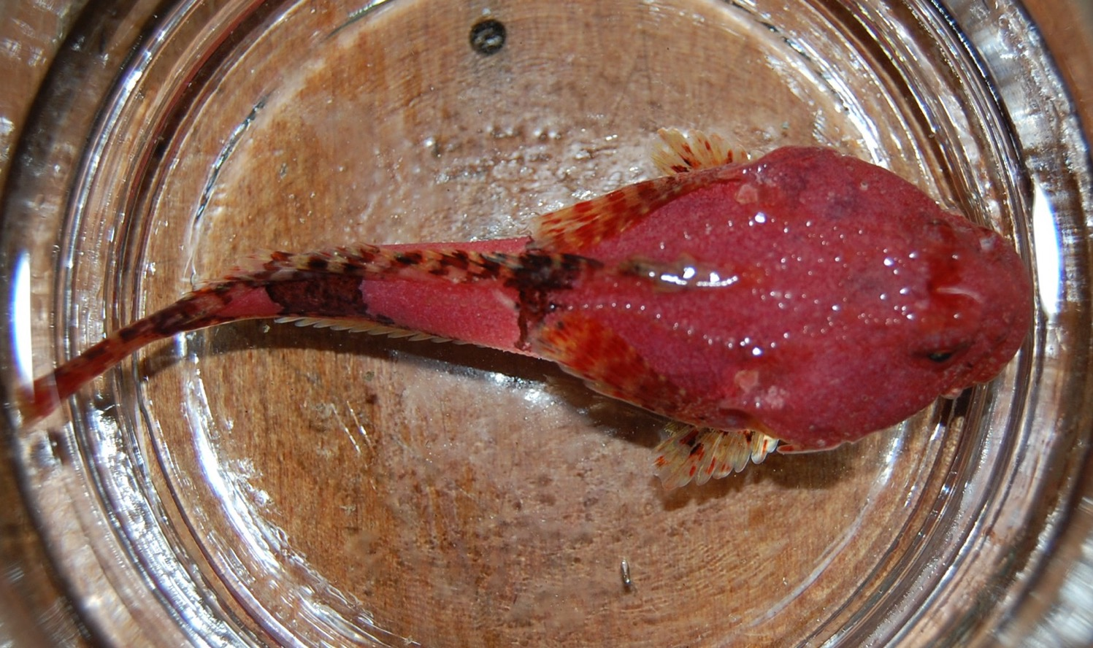
Spiny plunderfish, Harpagifer sp.

Slide 11
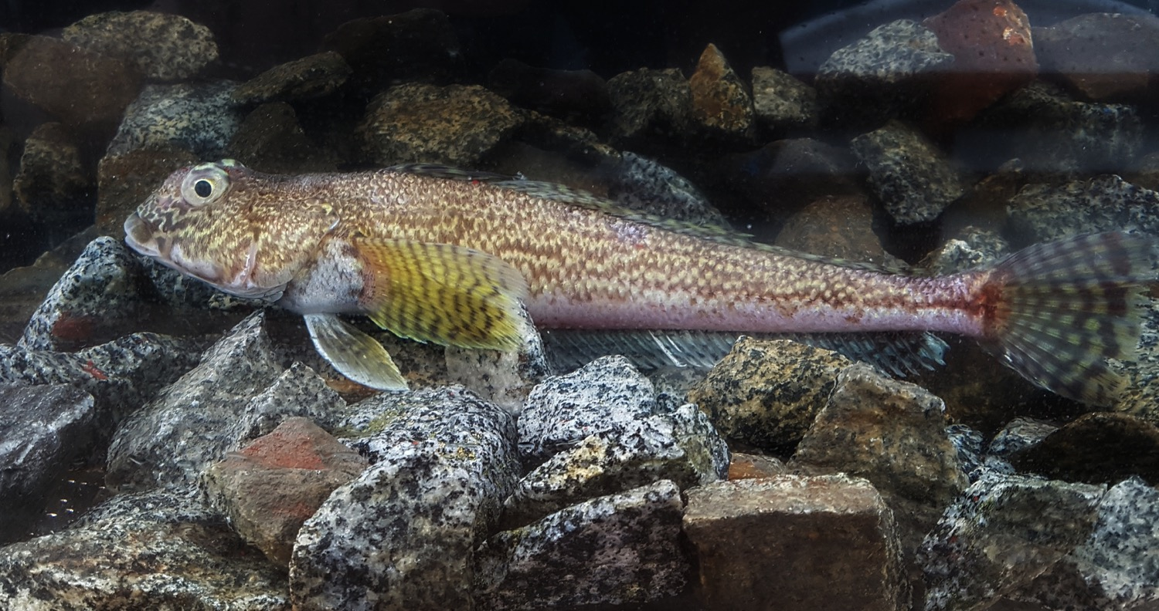
Humped rockcod, Gobionotothen gibberifrons
Photo credit: Michael Axelsson

Slide 12
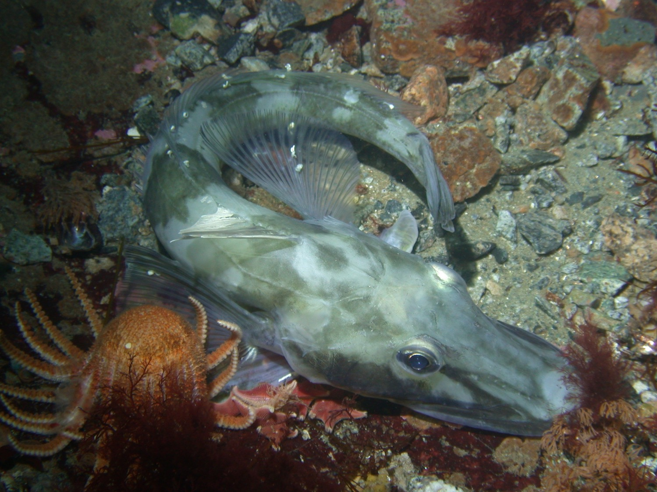
Blackfin icefish, Chaenocephalus aceratus
Photo credit: Bill Baker

Slide 13
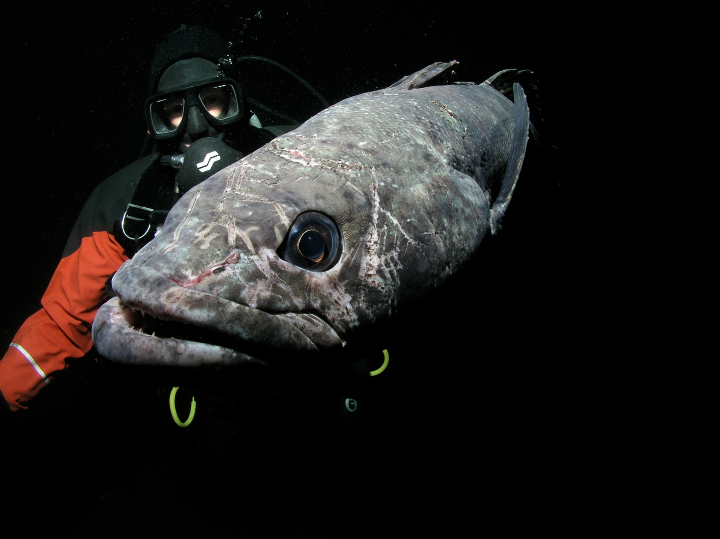
Antarctic toothfish, Dissostichus mawsoni
Photo credit: Rob Robbins

Slide 14
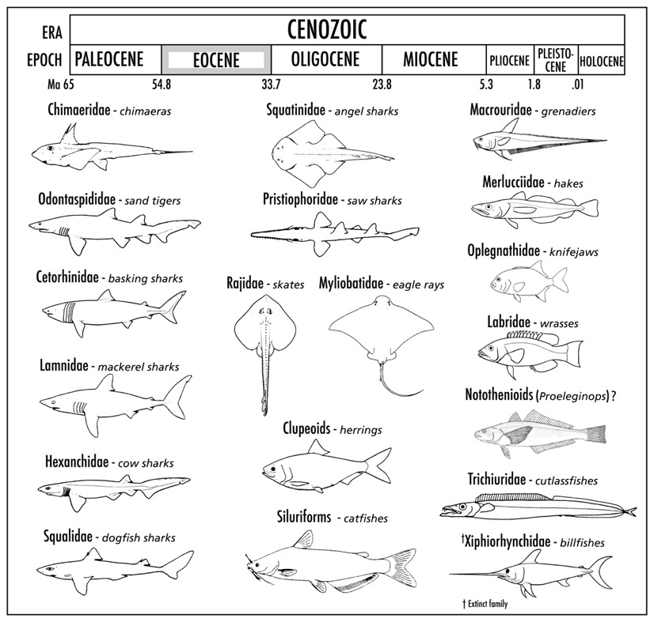
Diversity of fish fauna at Seymour Island, Antarctic Peninsula in the late Eocene
Today
Updated from: Eastman, Polar Biol. (2005) 28: 93–107

Slide 15
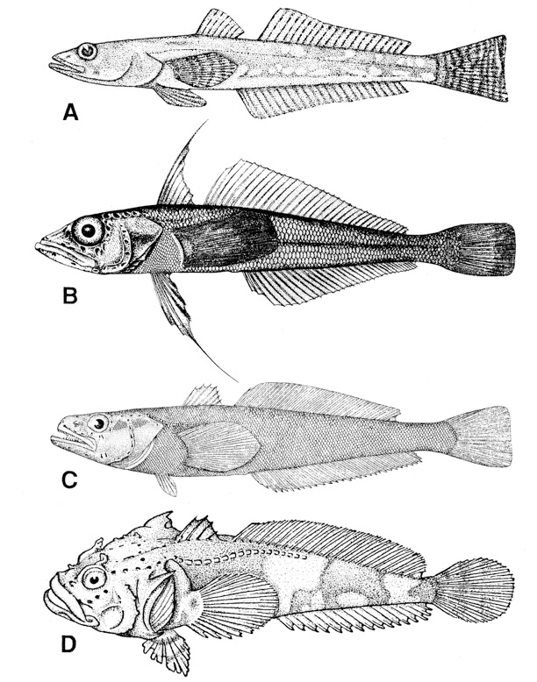
Adaptations of Antarctic notothenioid fishes
Antifreeze proteins
Proteins & membranes adapted to cold
Metabolic cold adaptation
From: Eastman, 1991, Amer. Zool. 31: 93-109

Slide 16
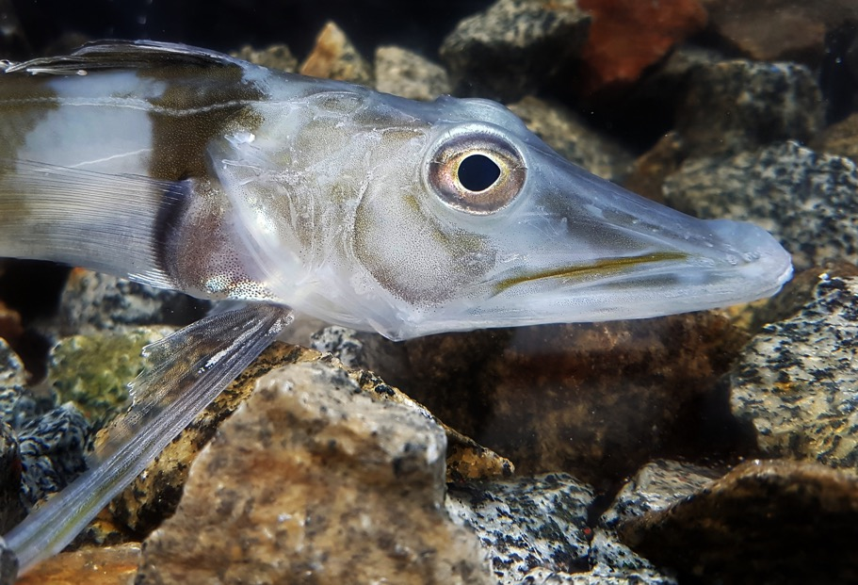
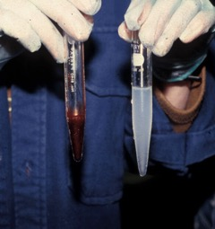
Traits also have been lost
Absence of O₂-binding protein hemoglobin (Hb) in the family Channichthyidae (icefish)
Blackfin icefish, C. aceratus
Photo credit: Michael Axelsson

Slide 17
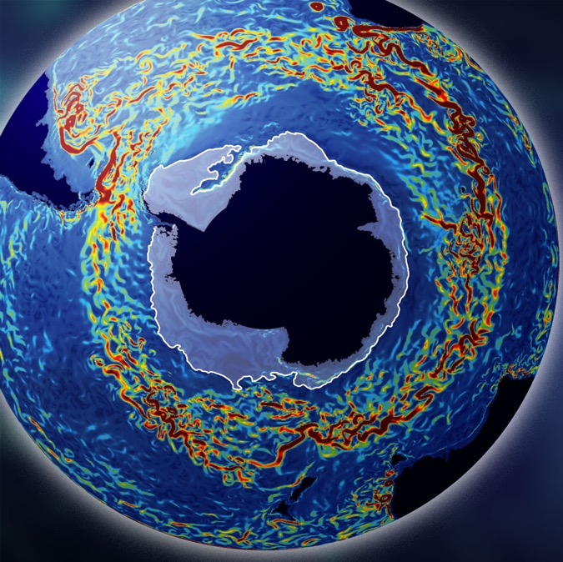
Unique geological and oceanographic history of the Southern Ocean permitted the survival of icefishes
Cold: < 5 °C for ~12 million years
Oxygen rich
Minimal competition
Image: M. Mazloff, MIT.
Source: San Diego Supercomputer Center, UC San Diego

Slide 18
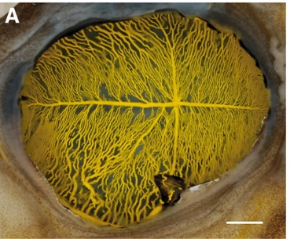
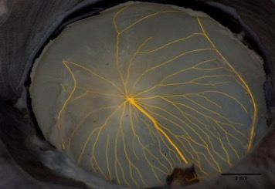
Recovery: Adaptations to the loss of Hb and Mb
Large blood volume
Enlarged heart
Large diameter blood vessels
Increased vascular density in some tissues
C. aceratus (-Hb) N. coriiceps (+Hb)
Wujcik et al. 2007. J. Exp. Biol. 210: 815-824

Slide 19
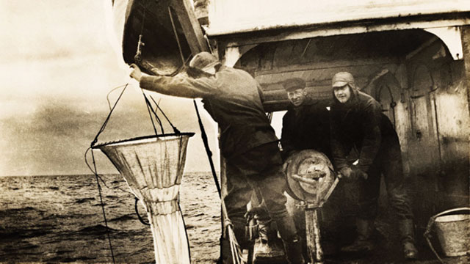
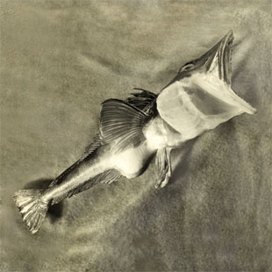
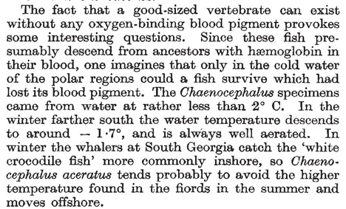
The Scientist (2013) D. Cossins/ Collection of Liv. Schjerven
Nature 1954 173: 848-850

Slide 20
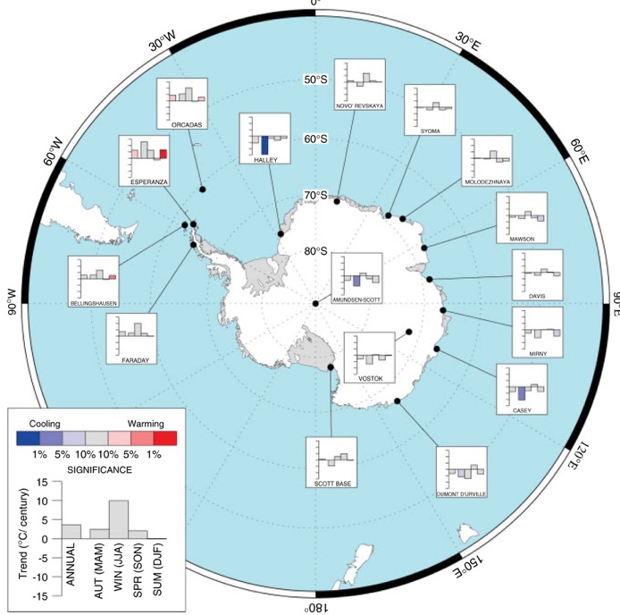
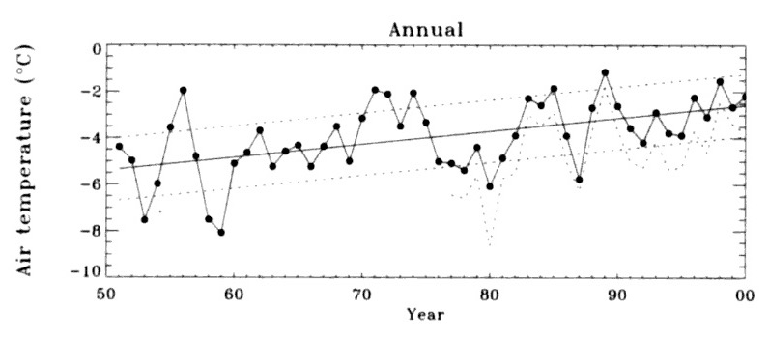
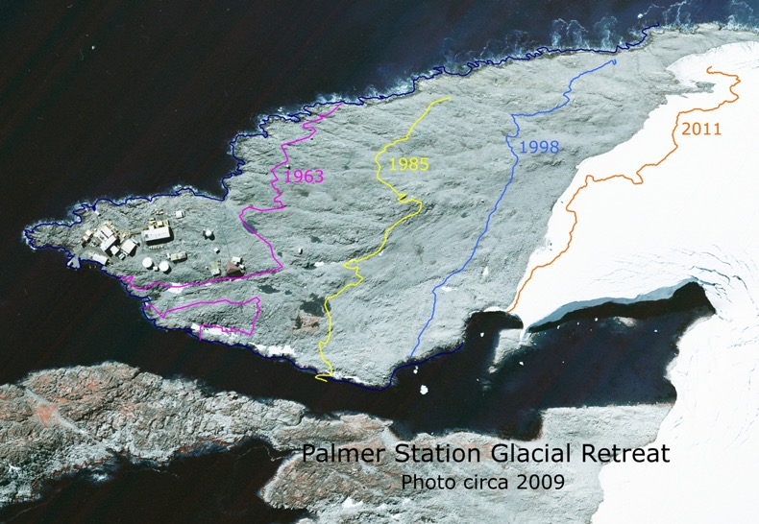
The Western Antarctic Peninsula region is rapidly warming
Mean air temperature at Vernadsky (65° S) and Rothera (67° S)
From Turner et al., (2005) Int. J. Climatol

Slide 21
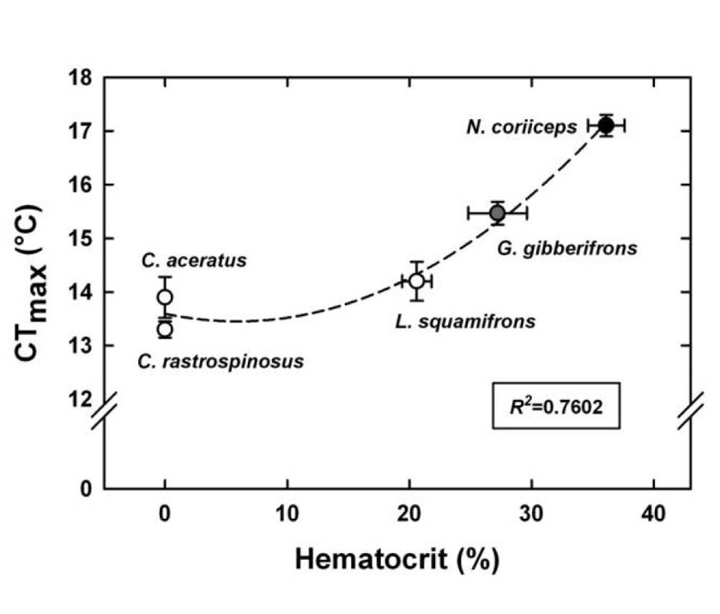
Critical thermal maximum is correlated with hematocrit
T. bernacchii
Beers and Sidell (2011) Physiol. Biochem. Zool. 84: 353-362
Modified based on Tetens et al., (1984) J. Exp. Biol. 109: 265-279, and Bilyk and DeVries (2011) Comp Biochem Physiol. 158: 382-390.

Slide 22
What are the biochemical and physiological underpinnings of thermal tolerance?
The heart is likely the weak link
What causes cardiac failure?
(1). Mitochondrial function
(2). Membrane integrity
(3). Ion channel function
How “plastic” are critical traits in response to temperature ?
What is the adaptive capacity of Antarctic fish to a warming climate?

Slide 23
Acknowledgements
Dr. Elizabeth Crockett
Devon Devor
Masters and crew of the R/V Laurence M. Gould
Support staff at Palmer Station

