Slide 1
Group #1
CDW diagram
Anim.cdwl4big.d20.gif
https://www.nature.com/articles/ngeo1391?proof=trueMay (scroll down to Figure 1)
Link to all models: http://www.ccpo.odu.edu/~msd/TUCKERTON/c

Slide 2
Group #1 Observations

Slide 3
Group #2
Salinity Model Surface and Cross Section
Anim.sss.d20.gif
Anim.s100m.d20.gif
Anim.scross.d20.gif
Link to all models: http://www.ccpo.odu.edu/~msd/TUCKERTON/c

Slide 4
Group #2 Observations

Slide 5
Group #3
Temperature Model Surface and Cross Section
Anim.sst.d20.gif
Anim.t100m.d20.gif
Anim.tcross.long.d20.gif
Link to all models: http://www.ccpo.odu.edu/~msd/TUCKERTON/c

Slide 6
Group #3 Observations

Slide 7
Group #4
Vectors at 20 and 100m
Anim.vector.20m.d20.gif
Anim.vector.100m.d20.gif
Link to all models: http://www.ccpo.odu.edu/~msd/TUCKERTON/c

Slide 8
Group #4 Observations

Slide 9
Group #5
Model of SSH
Anim.ssh.d20.gif
Link to all models: http://www.ccpo.odu.edu/~msd/TUCKERTON/c

Slide 10
Group #5 Observations

Slide 11
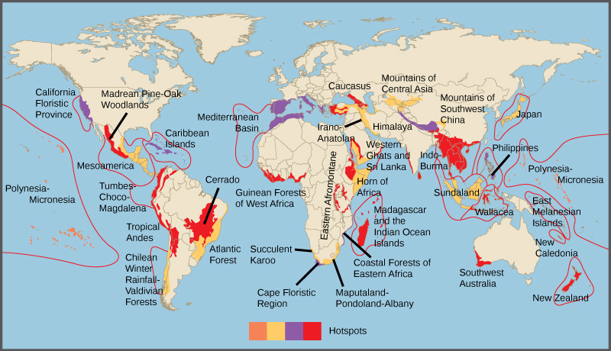
What do you think a biological hotspot is?

