Slide 1
Revising Testable Questions

Slide 2
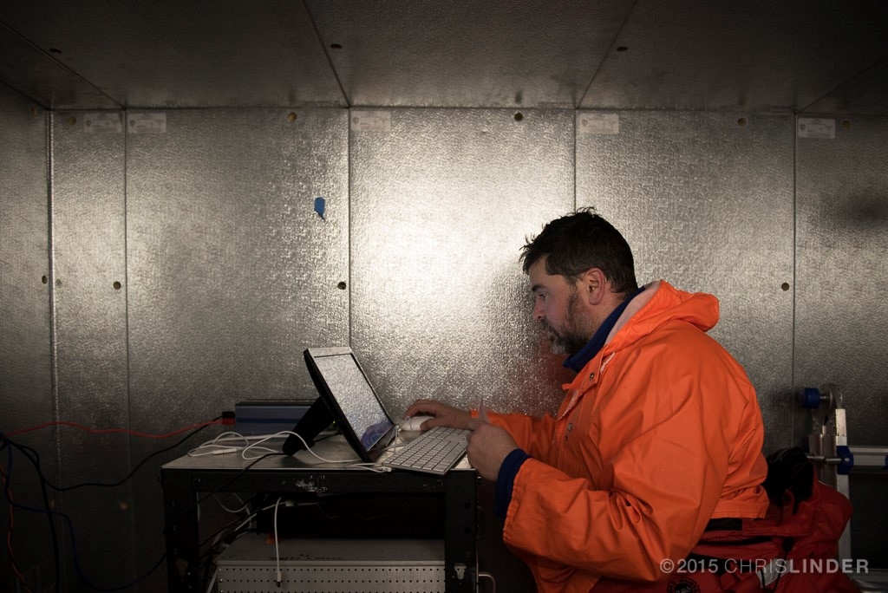
Testable questions are used by scientists.
Testable questions…
Can’t be looked up online or in print
Use datasets to answer the question being asked
?
?
?

Slide 3
Changed to: How does the average daily water temperature in Palmer Deep change over a year?
Notes:
Example of what the students can create when brainstorming. There is no correct answer here and this process can be done in student notebooks or any way you can engage your students.

Slide 4
What data do we need to answer this question?

Slide 5
What data do we need to answer this question?
Temperature data for a one year period in the Palmer Deep.

Slide 6
What data do we need to answer this question?
Temperature data for a one year period in the Palmer Deep.
Do we have all the data we need to answer this question?
No! We do not have one years worth of temperature data for the Palmer Deep.

Slide 7
What do we do next?
Option 1: Conduct more research
Option 2: Find the missing data from another source
Option 3: Revise the question

Slide 8
Revised Question: How does the average daily water temperature in Palmer Deep change from January 1 to February 1?

Slide 9
Revise Your Testable Question
Use the same groups that created the testable questions.
What data do you need to answer the testable question you developed?
Do you have the data you need to answer the question? If not, can you get the missing data from another source?
Revise your question based on this information
Notes:
The teacher can organize the groups as they see fit for their class.

Slide 10
Gallery Walk
Stick the post-it next to the testable question you’re commenting on.
Help them create the best SMART question possible & keep the feedback positive!
Give feedback to your classmates on the post-it!

Slide 11
Revise your Question
?
Take the post-its back to your group and make edits to your question based on the feedback.
?
?
Notes:
Give students time to revise and rewrite their testable question under their old question or on the back of their white paper. Keep the post-its and white paper together.

