Slide 1
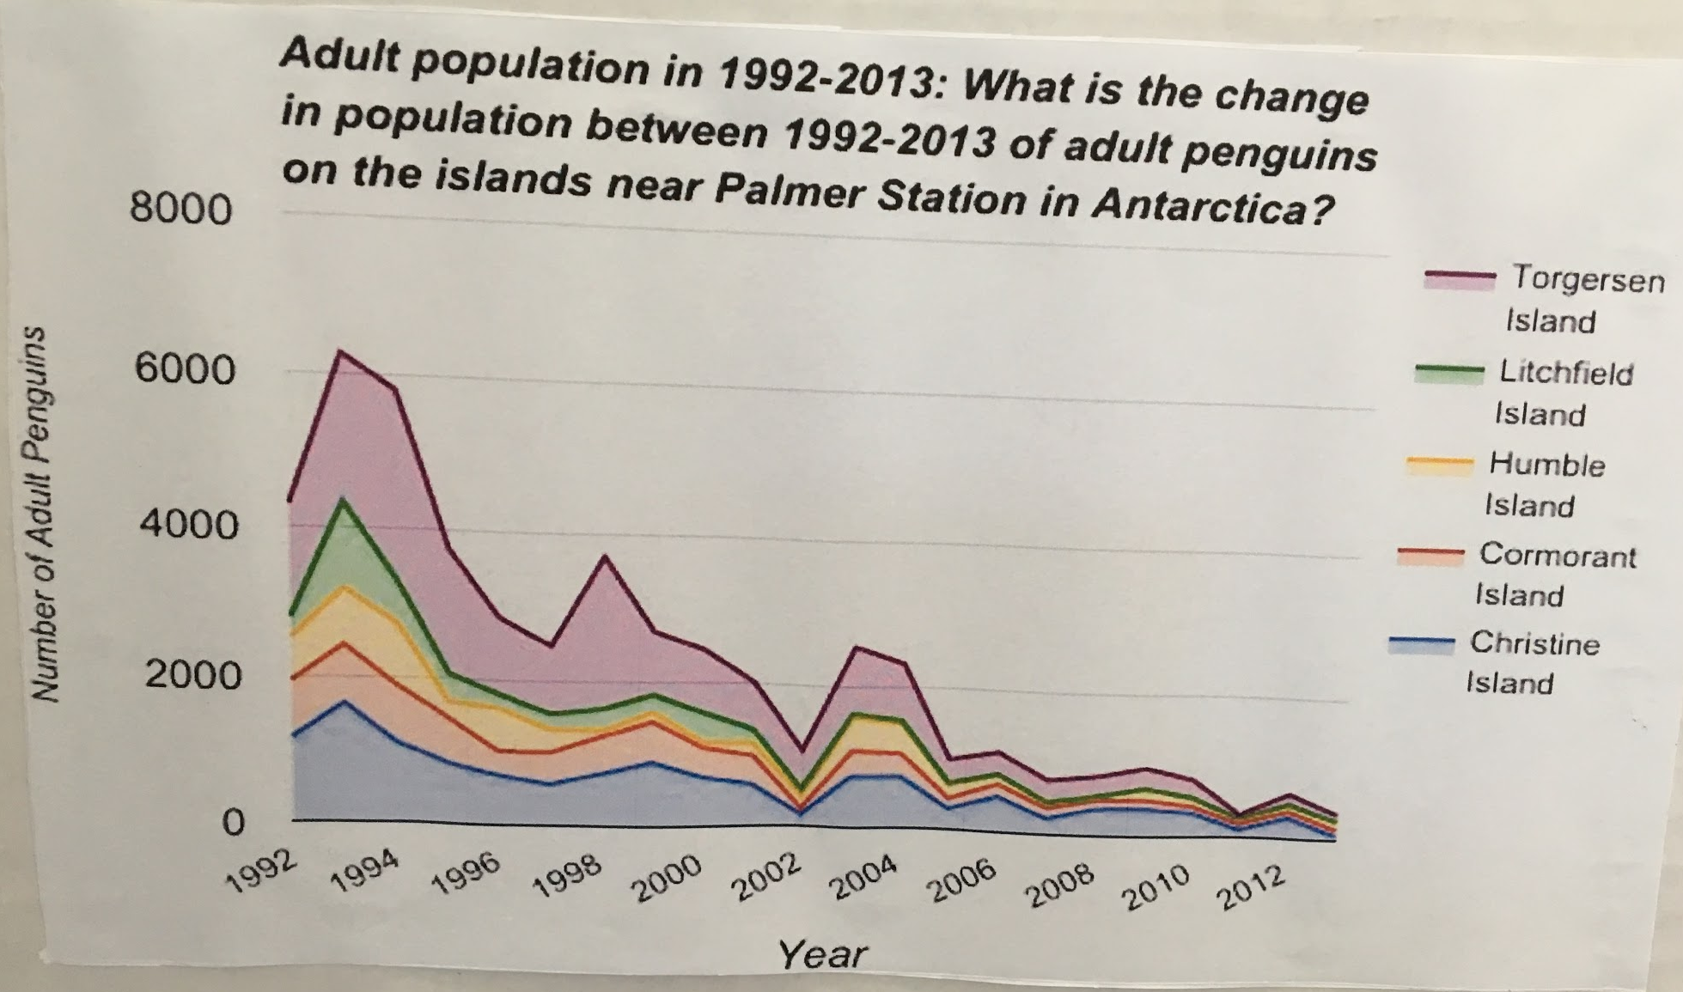
What is the change in population between 1992-2013 of adult penguins on the islands near Palmer Station in Antarctica?

Slide 2
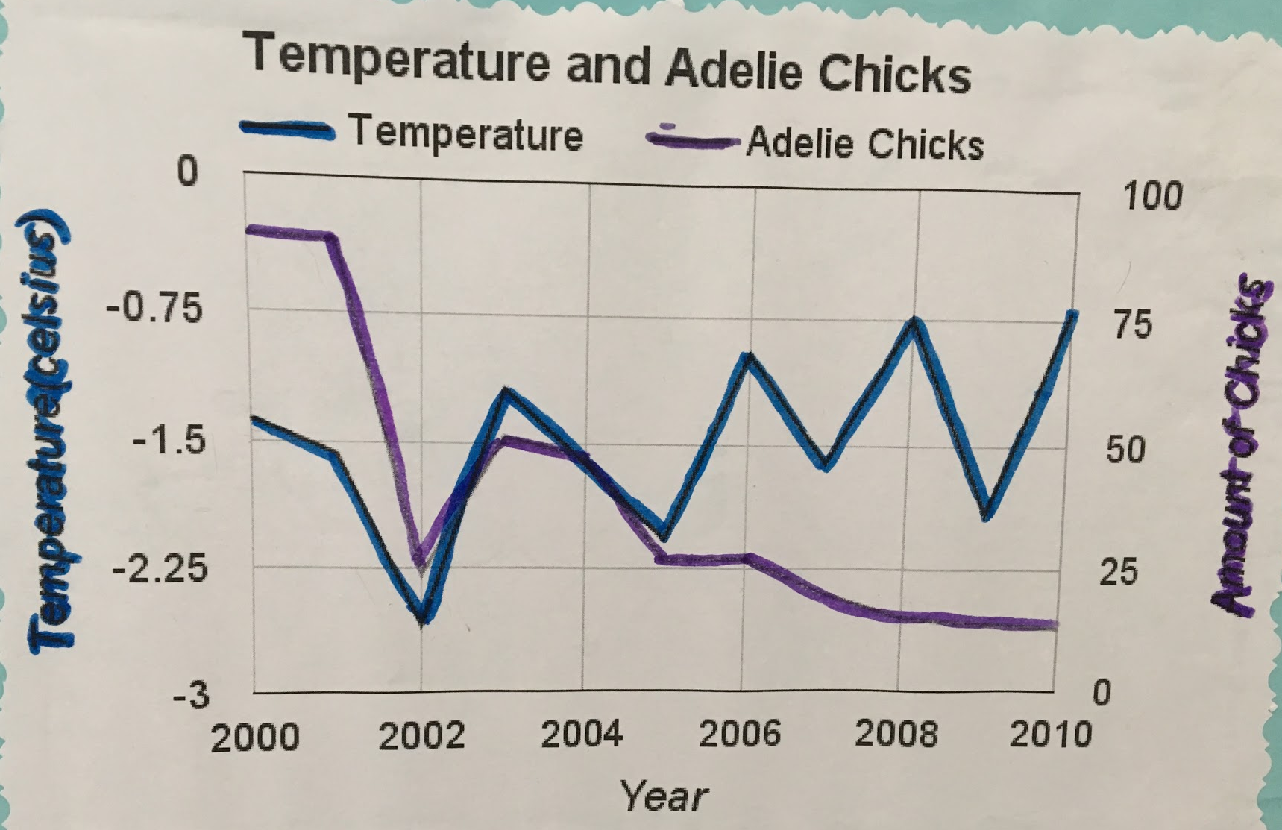
How has the average temperature from 2000-2010 affected the number of chicks in Palmer Stations Antarctica?

Slide 3
What is going on with phytoplanktons population and is the water temperature causing it?

Slide 4
How has the average temperature at Palmer Weather Station from 1974-2016 Antarctica changed?

Slide 5
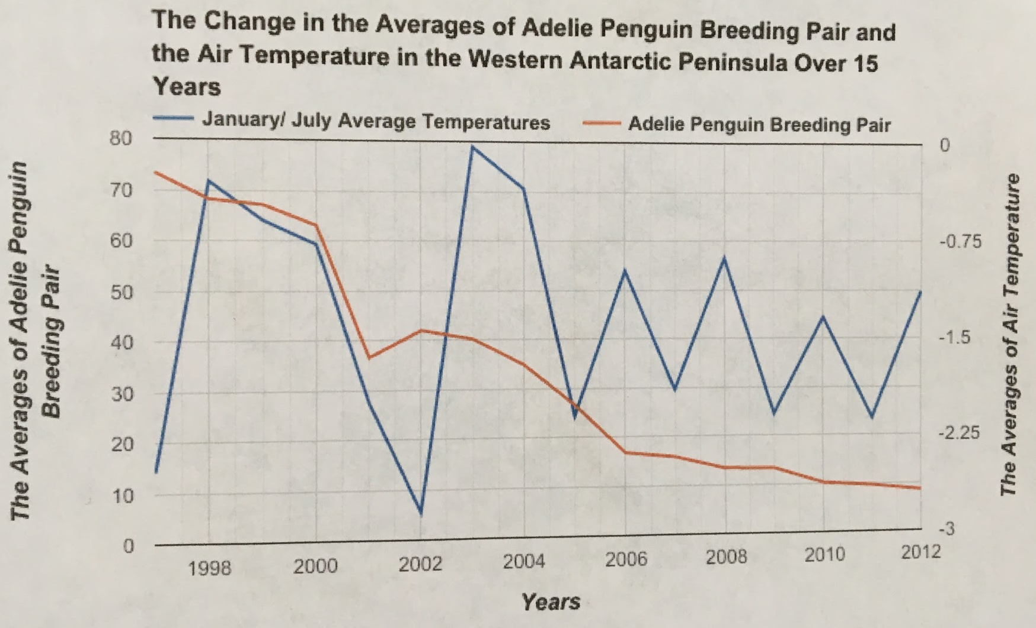
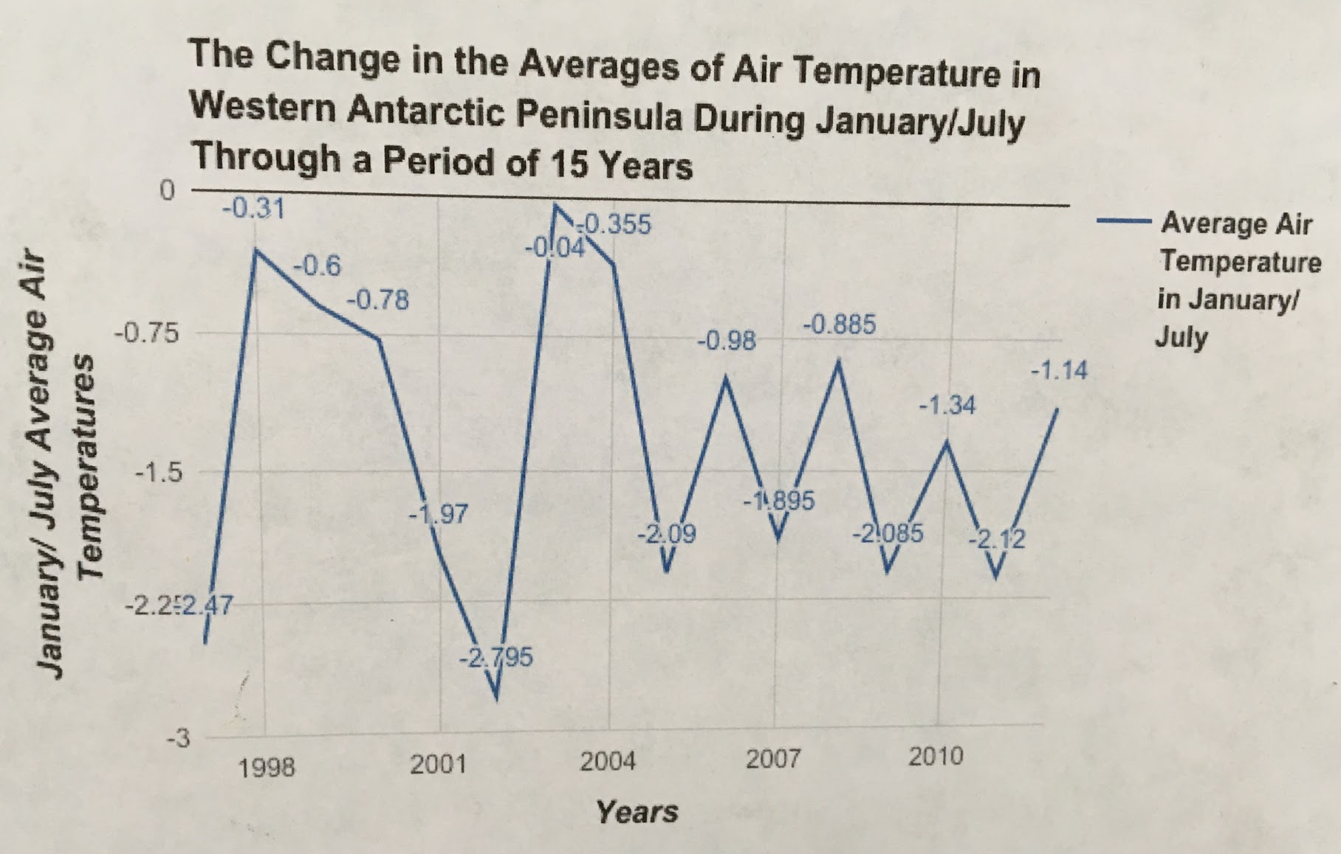
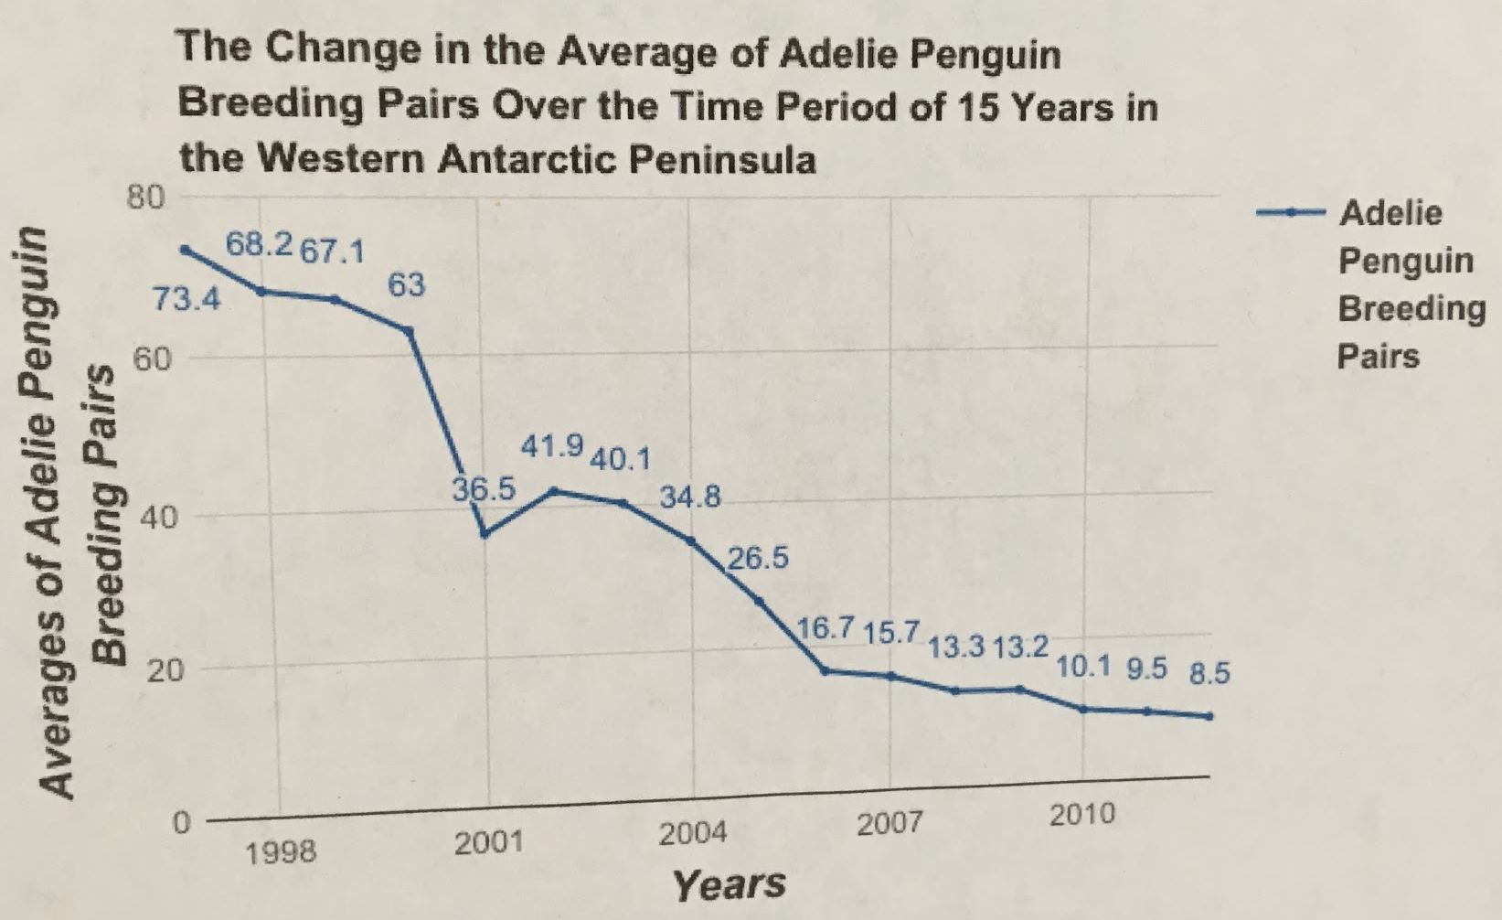
In the last 15 years, how did the rising air temperature in the Western Antarctic Peninsula affect the population of the Adelie penguin breeding pair?

Slide 6
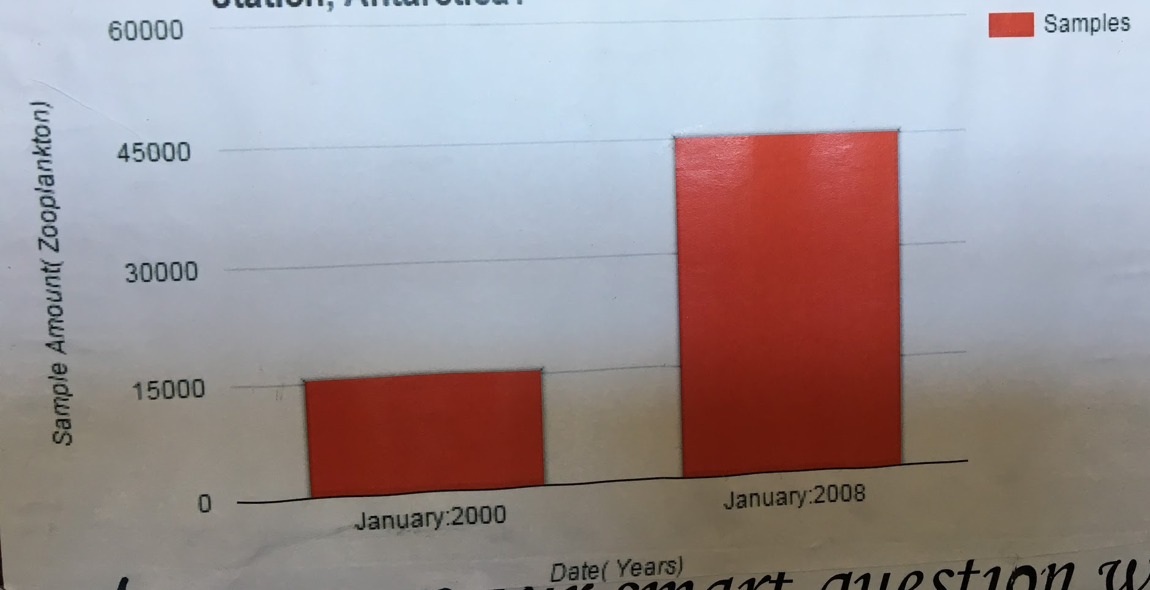
How has the zooplankton population changed from 2000 in comparison to 2008 at Palmer Station, Antarctica?

Slide 7
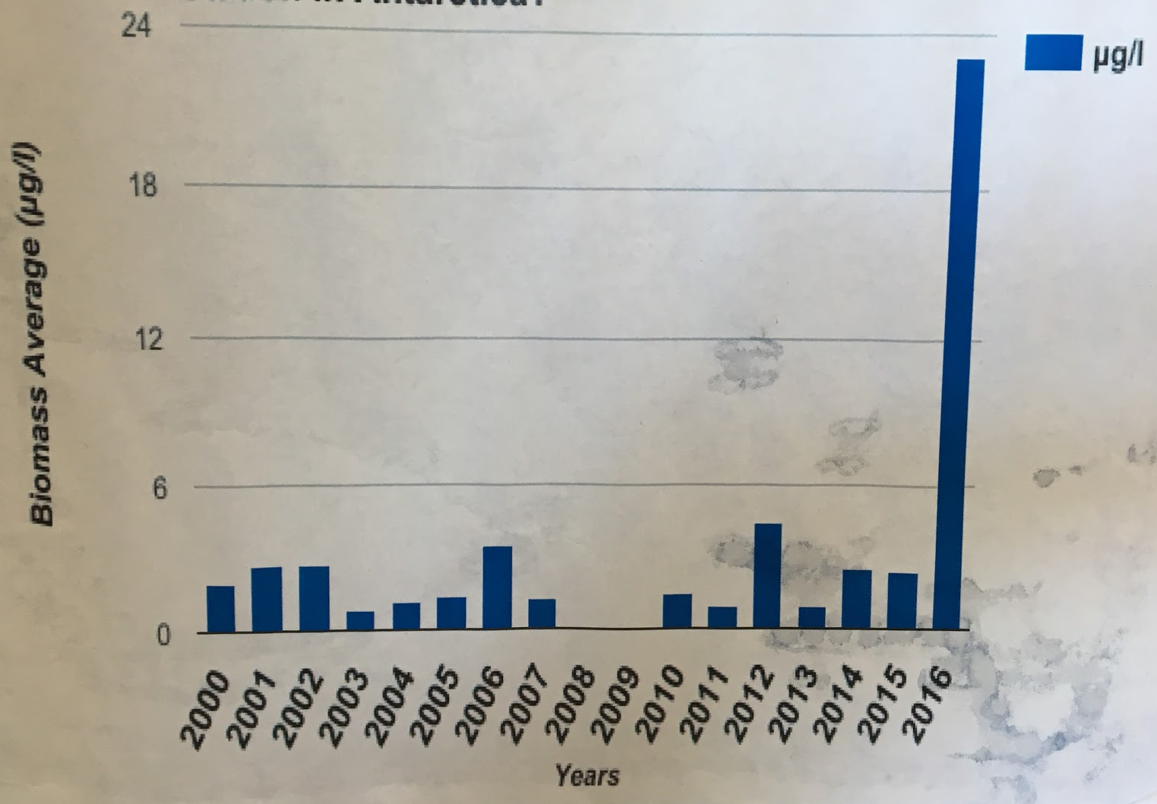
How has the average amount of “Chlorophyll a” changes from 2000 through 2016 at Palmer Station in Antarctica?

Slide 8
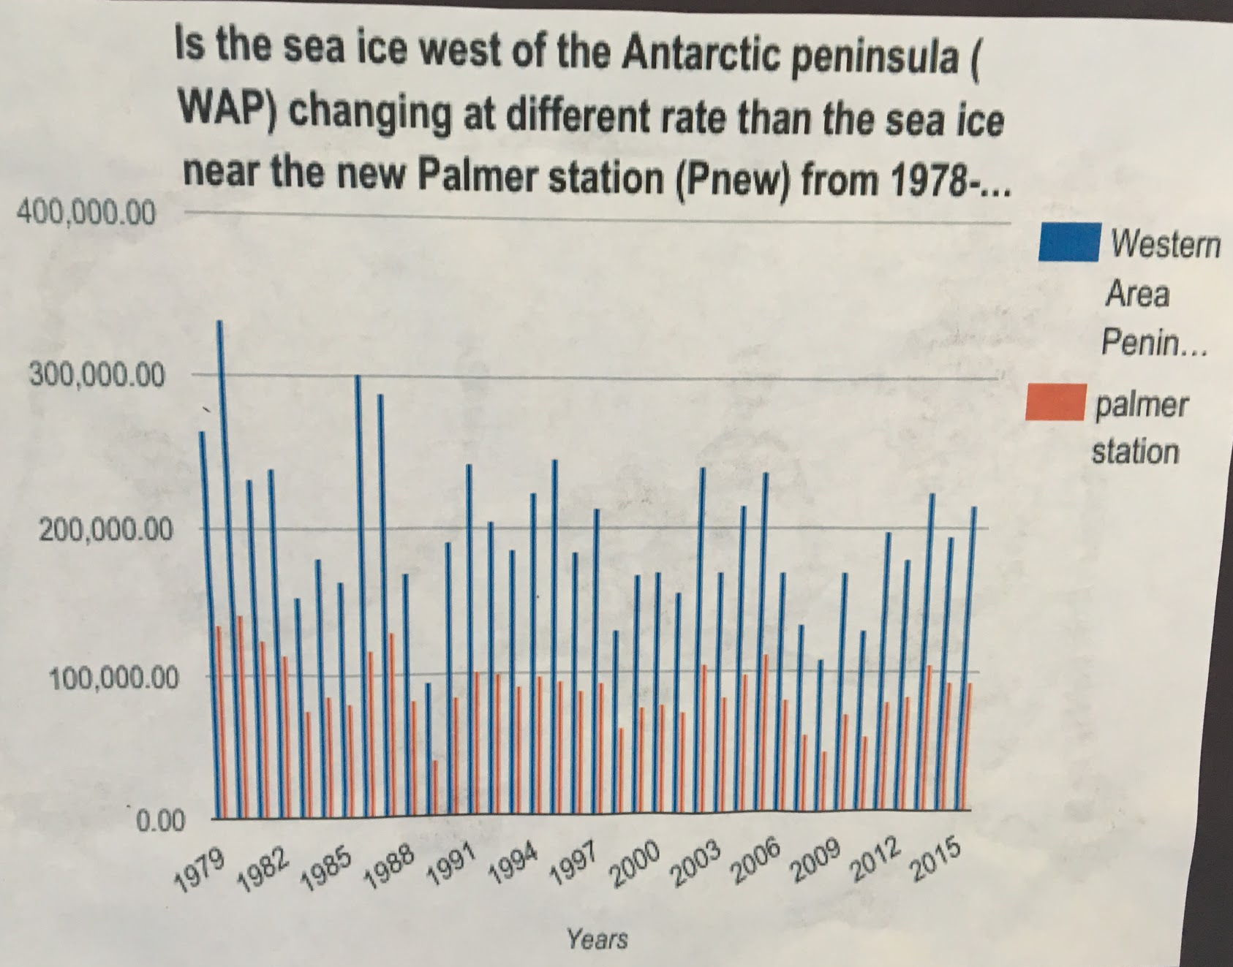
Is the sea ice on the Western Antarctic Peninsula changing at a different rate than the sea ice near Palmer Station from 1978-2015?

Slide 9
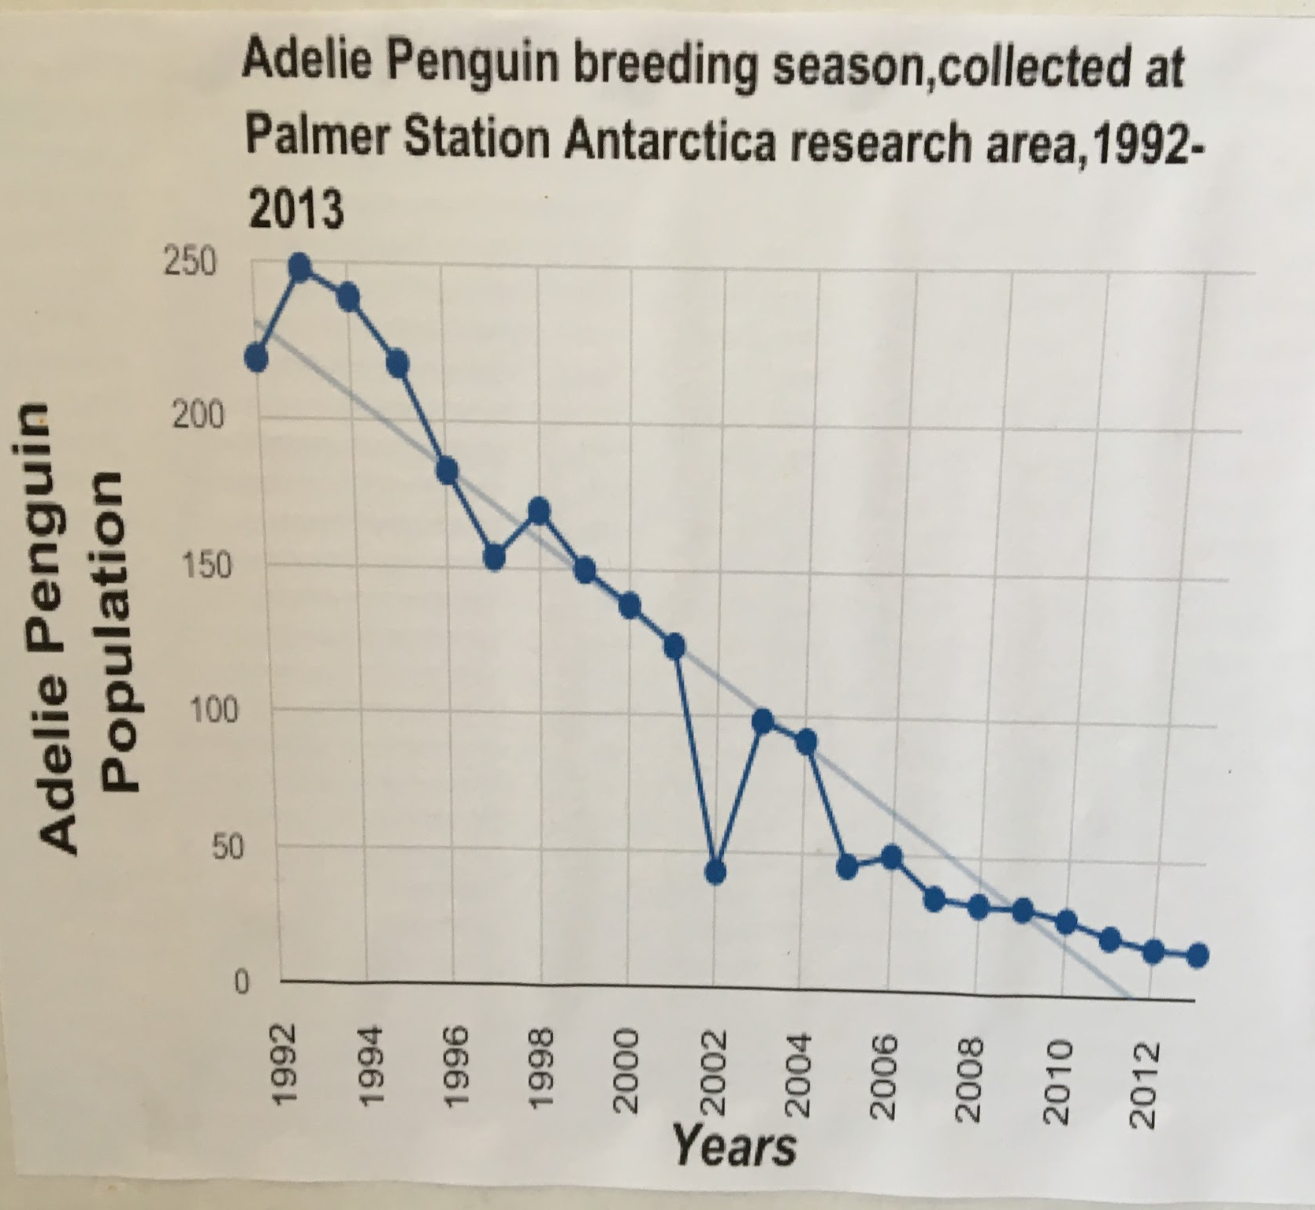
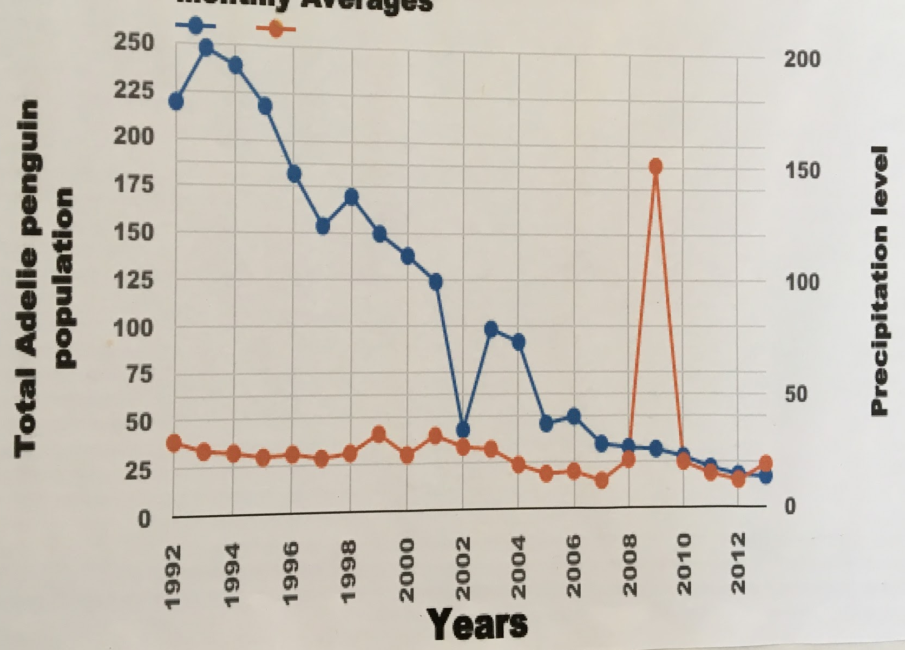
Do you think if precipitation increases in Antarctica then the Adelis population will decrease?

