Slide 1
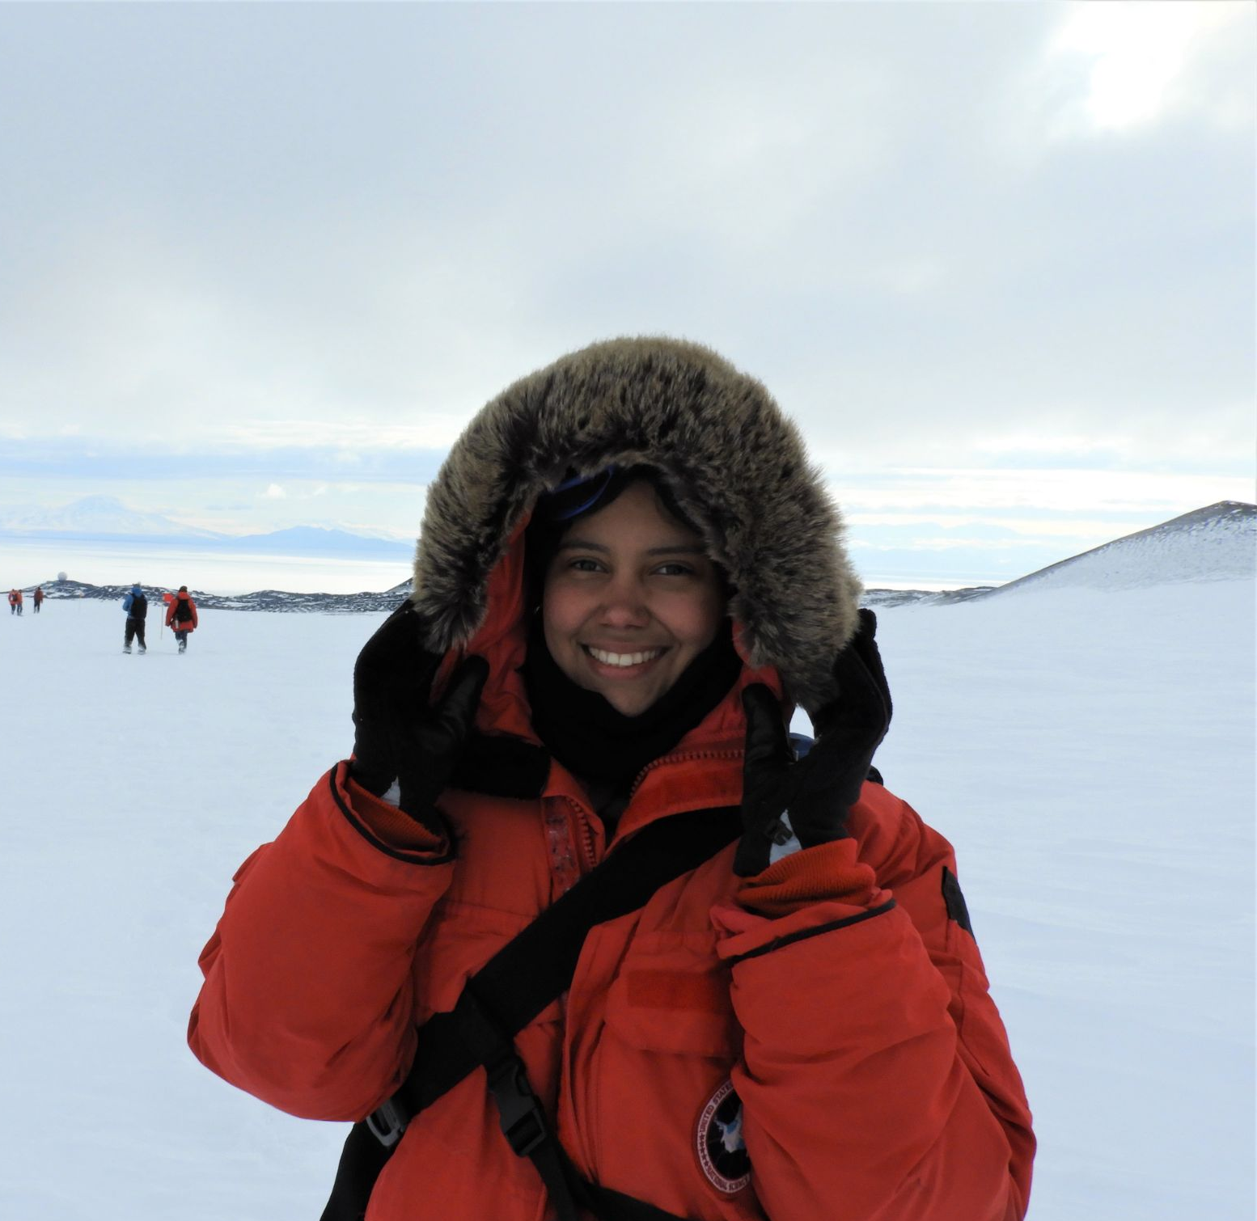
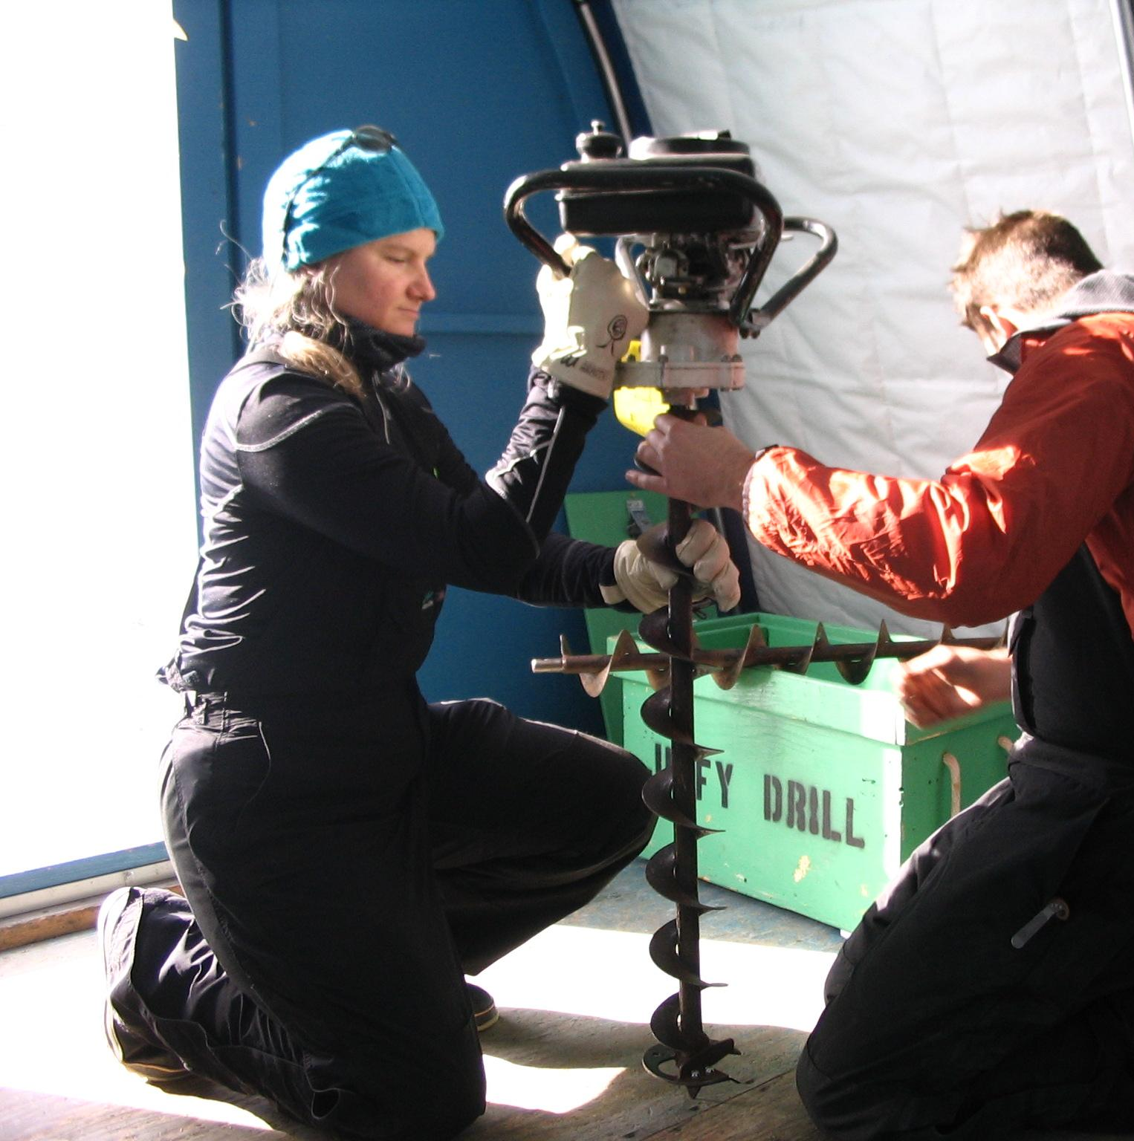
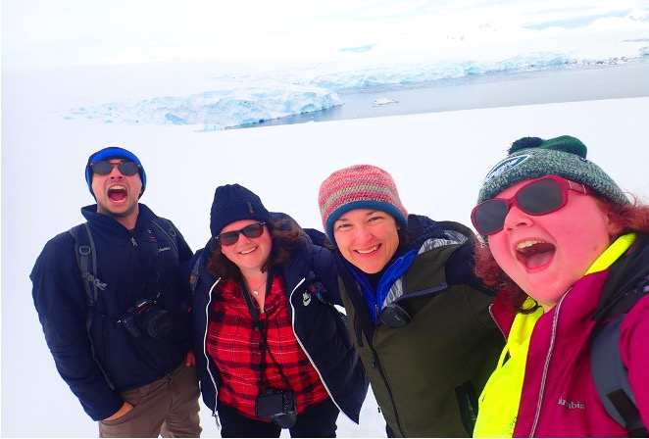
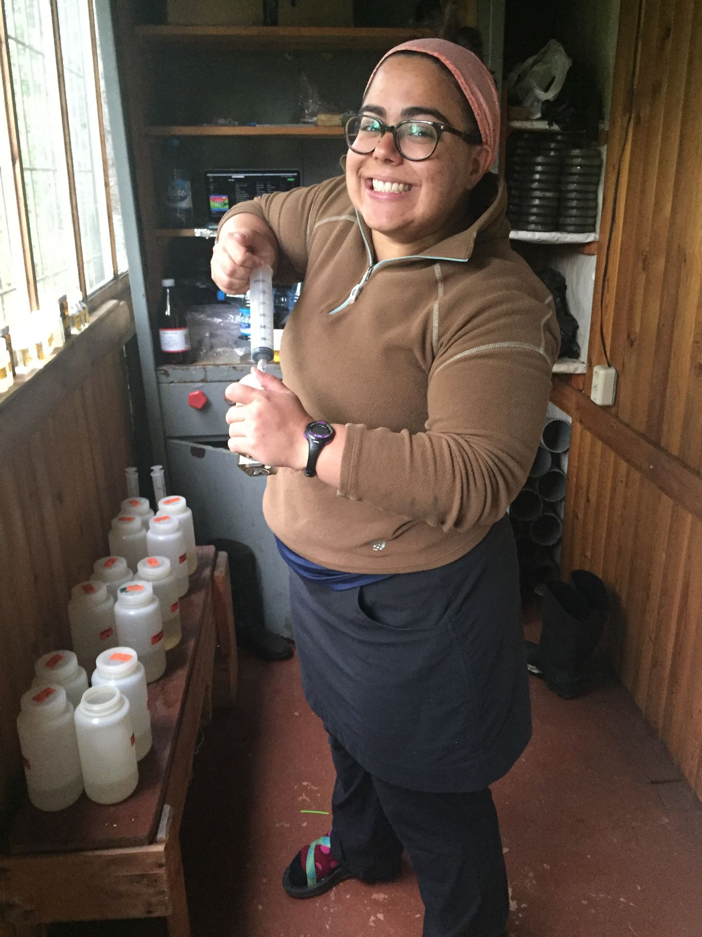
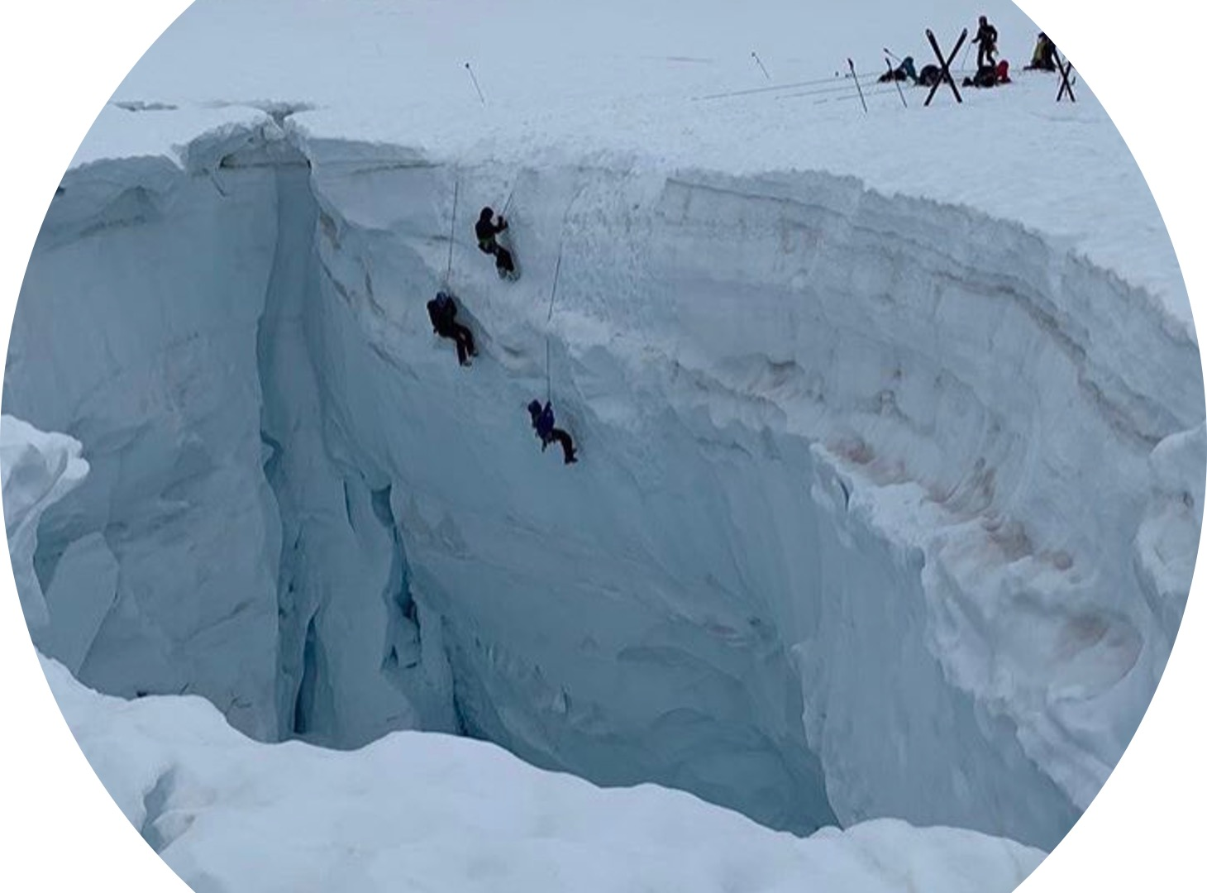
What Polar Researcher are You Today?
A
B
C
D
E
Notes:
A-Melisa Diaz
B-Dr. Rachel Morgan-Kiss
C-Kasey Walsh, and others
D-Bianca Rodriguez Cardona
E-Dr. Michalea King rescue training

Slide 2
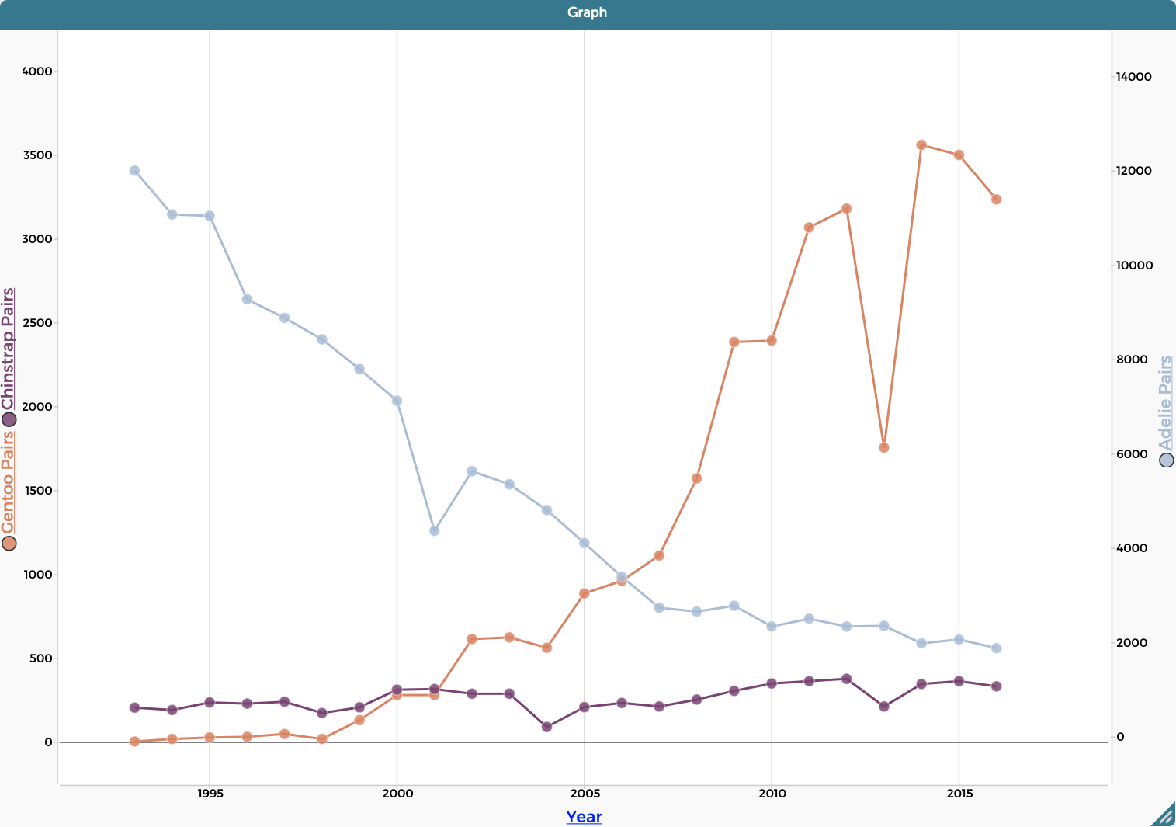
What Graph are You Today?
A
Adelie
Gentoo
C
Chinstrap
B
Notes:
Graphs of penguin population changes

Slide 3
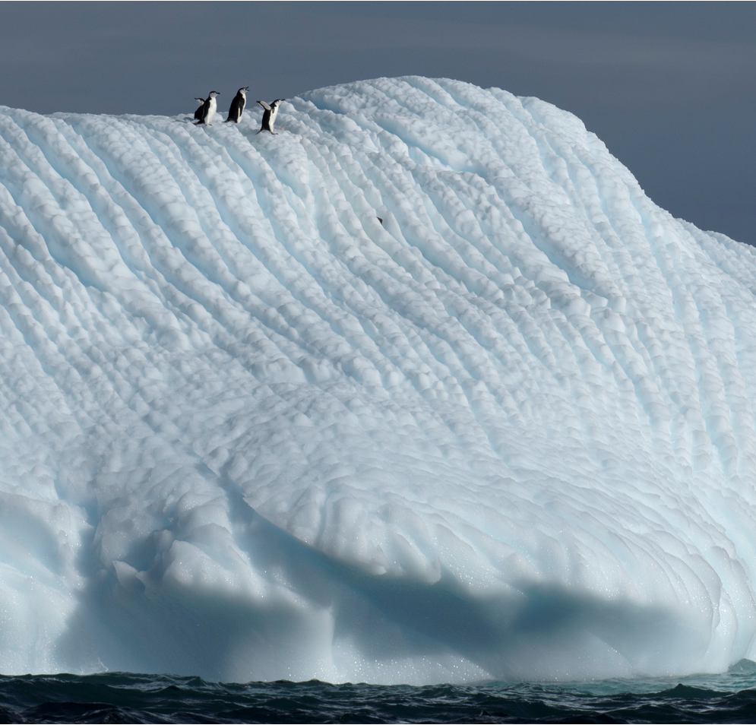
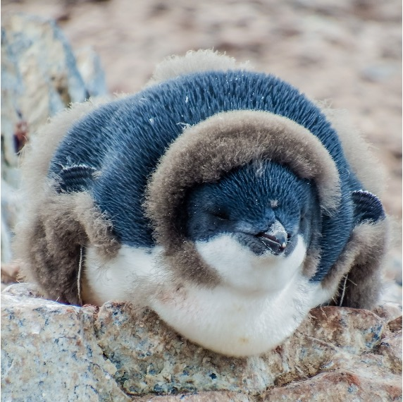
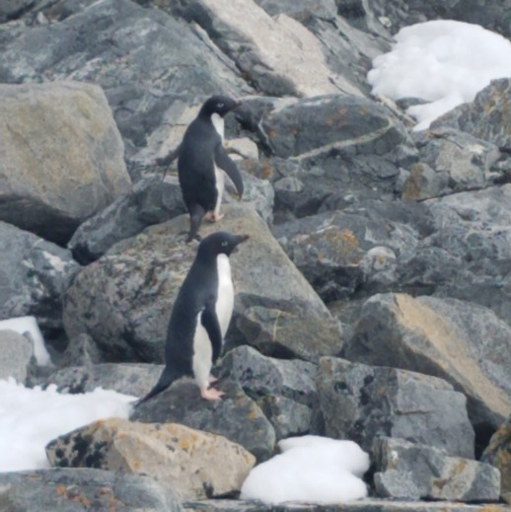
What Penguin are You Today?
A
B
C
D
Notes:
A-Chinstrap penguins
B-Adelie penguin losing adolescent feathers
C-Adelie penguins
D-Gentoo penguins
Picture Credits
A,B,D-Andrew Corso
C-Kasey Walsh

Slide 4
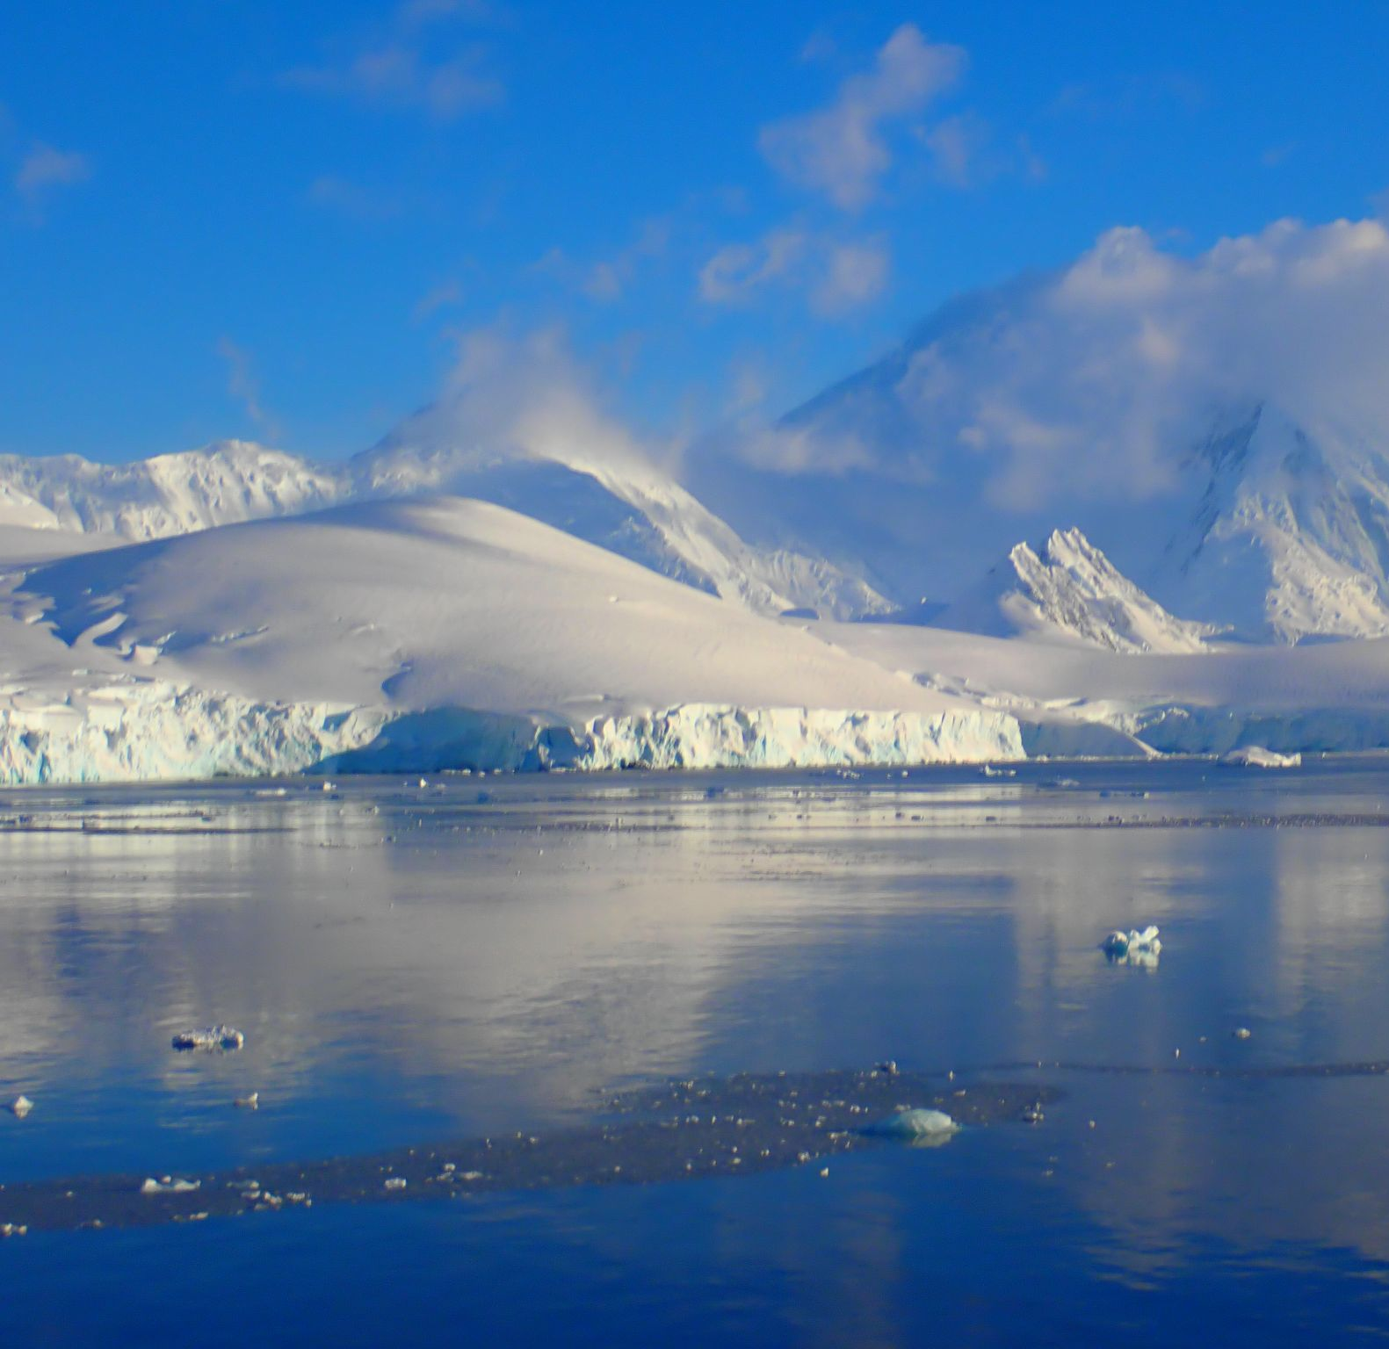
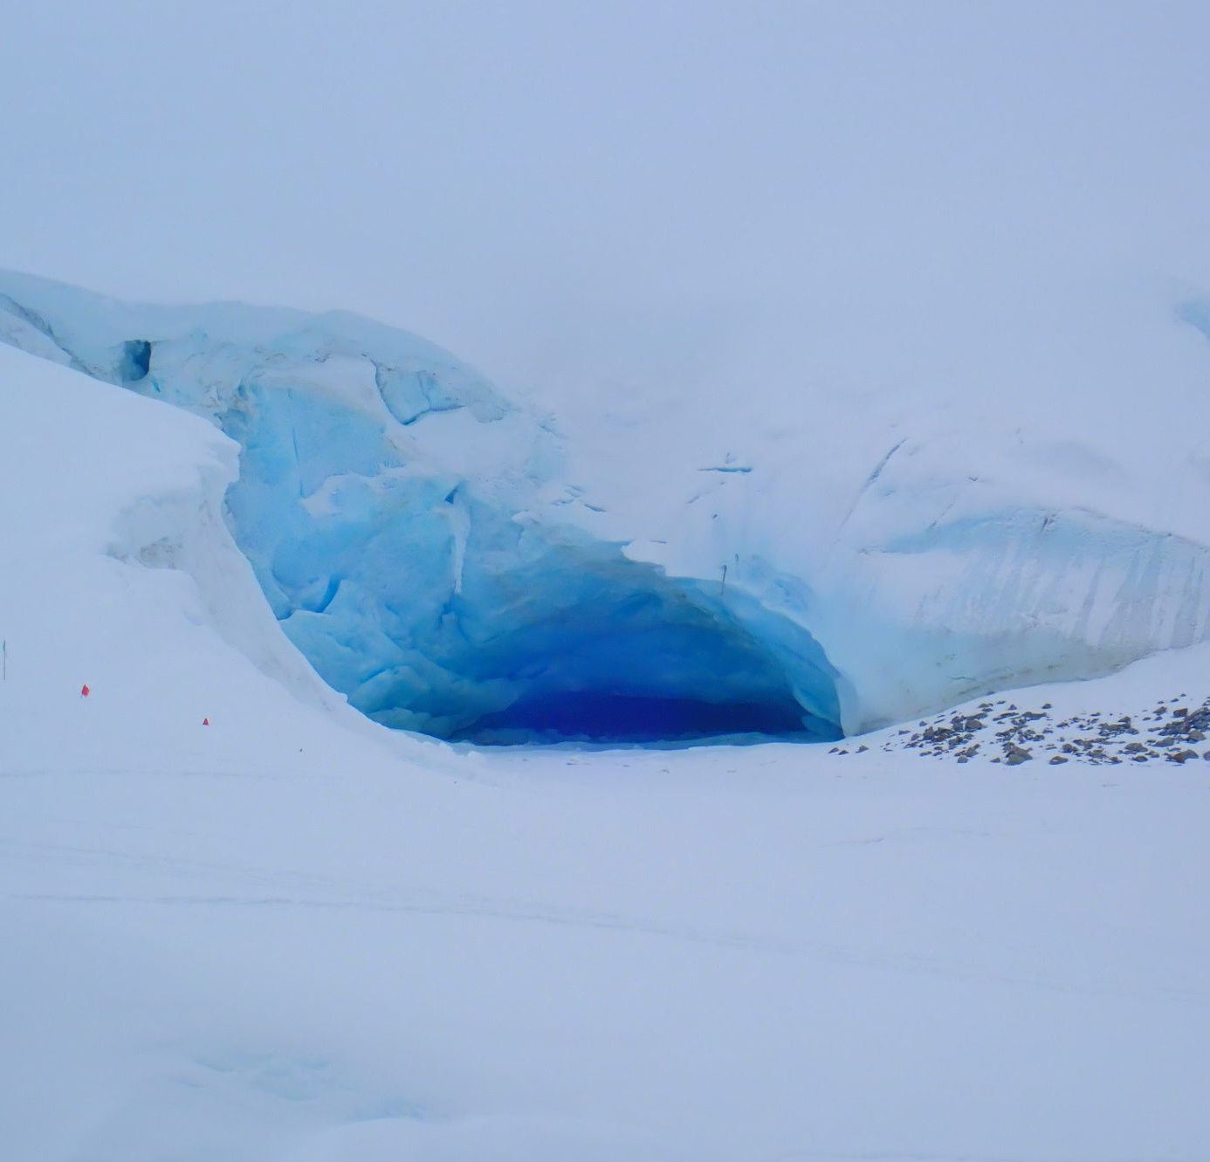
What Ice are You Today?
A
B
C
D
Notes:
A-Small piece of floating sea ice
B-Mountains in Antarctica
C-Antarctic glacier
D-Larger piece of floating sea ice
All images, Kasey Walsh

Slide 5
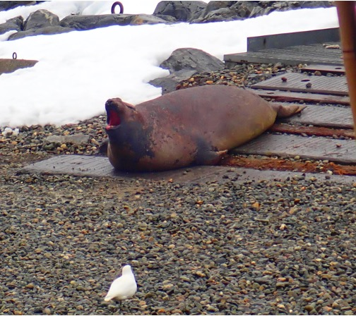
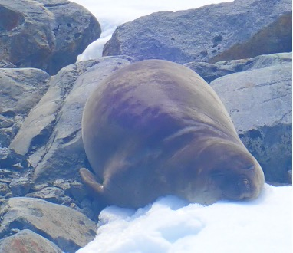
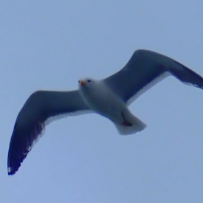
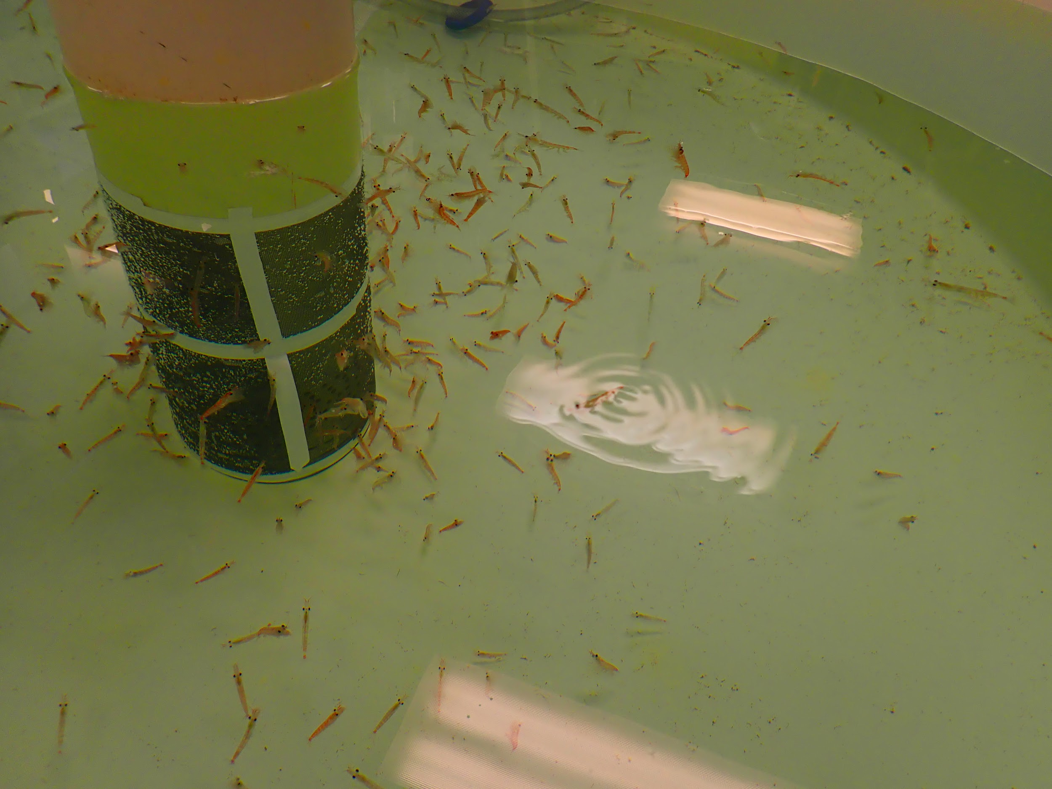
What Animal are You Today?
A
B
C
D
Notes:
A-
B-
C-Wandering Albatross
D-Krill
All images, Kasey Walsh

Slide 6
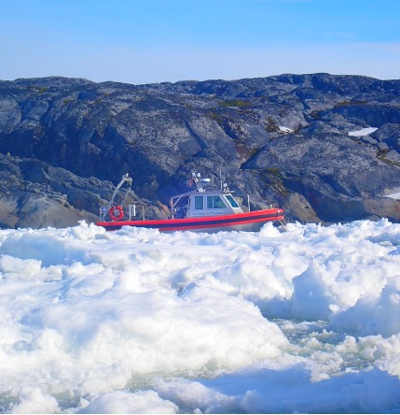
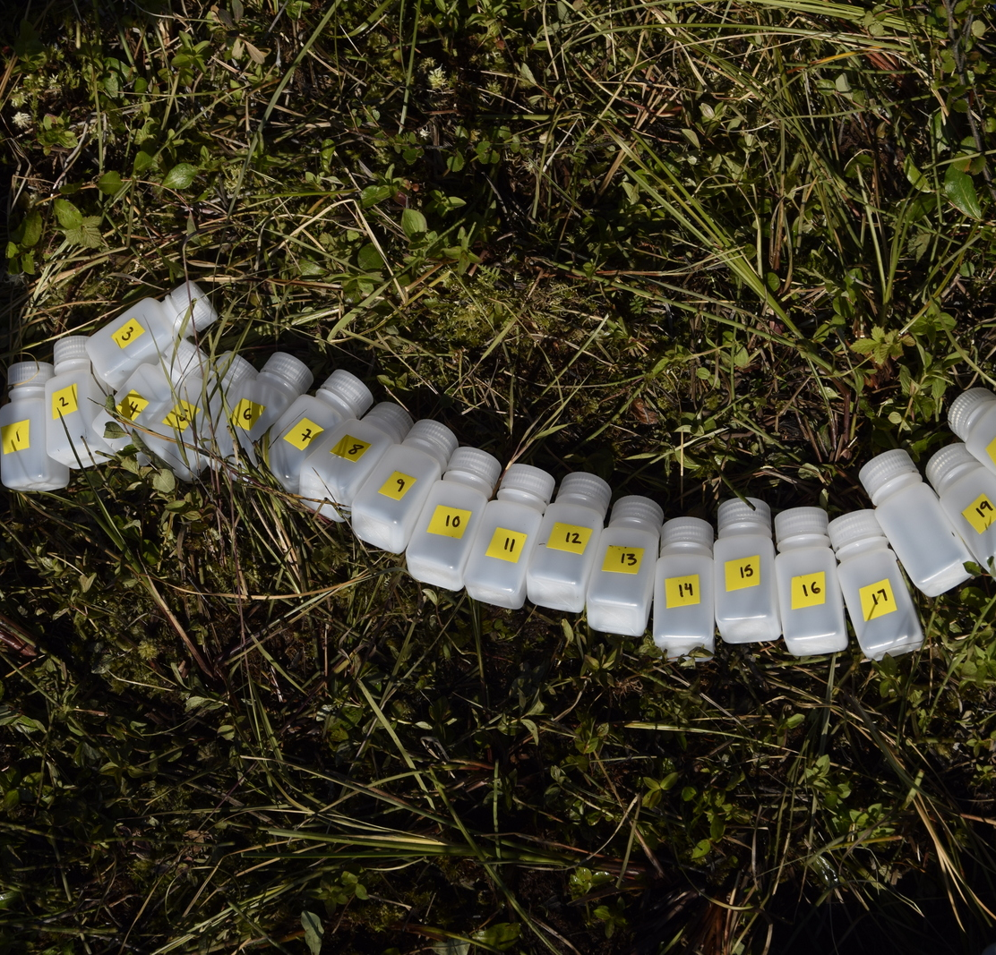
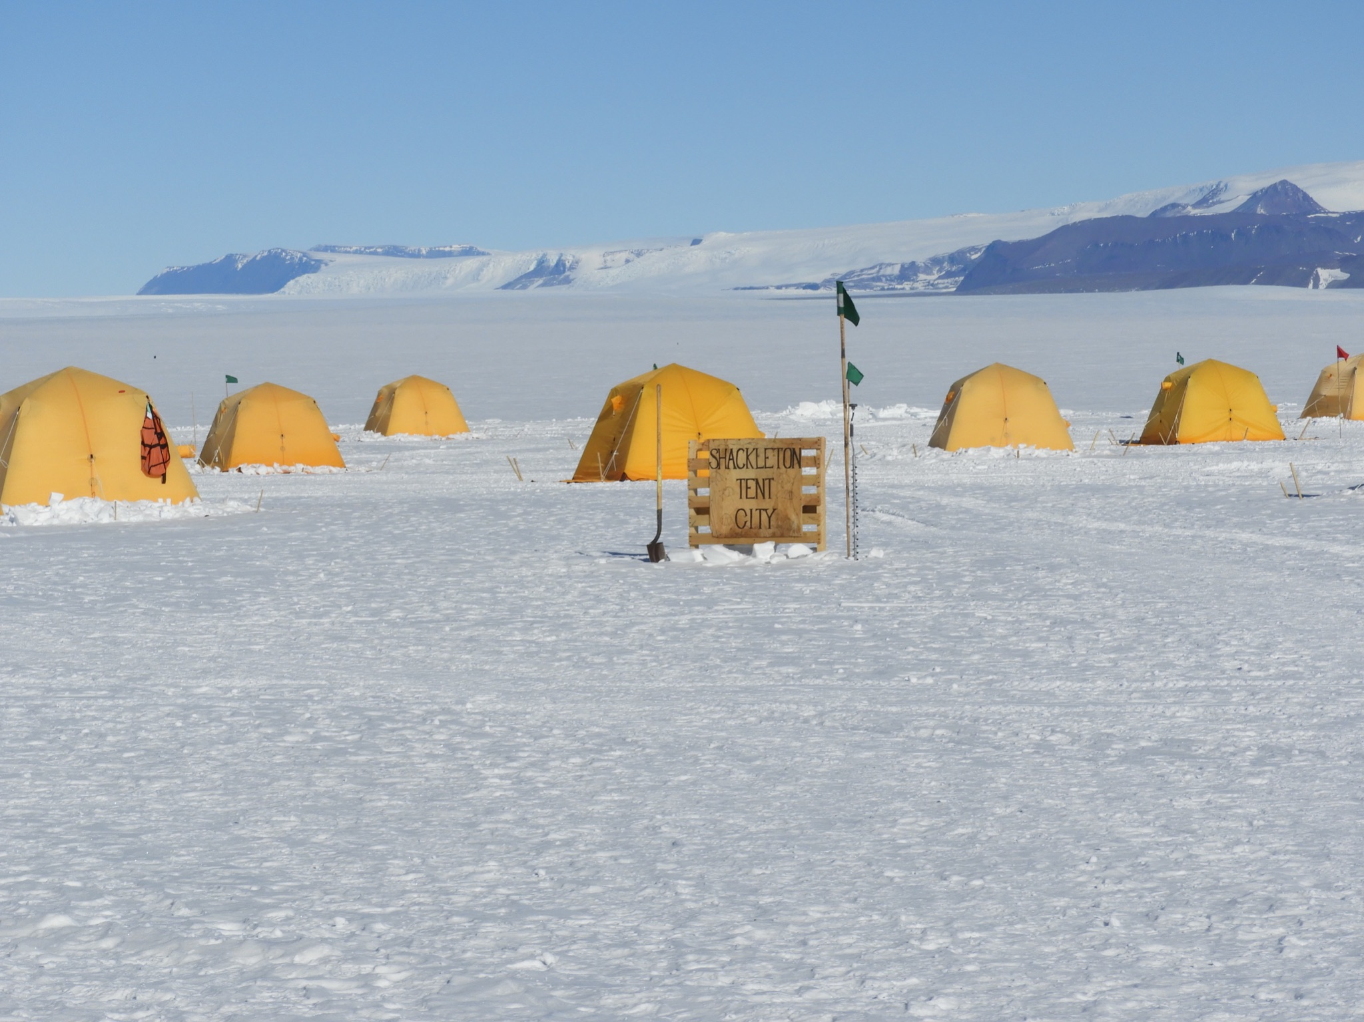
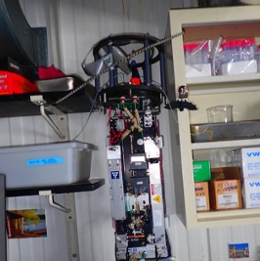
What Instrument are You Today?
A
B
C
D
E
Notes:
A-Research boat
B-Sample bottles
C-Tents
D-”Floyd” an imaging robot
E-Hand auger to drill ice
Picture Credits:
A & D-Kasey Walsh
B-Bianca Rodriguez-Cardona
C-Stacy Porter
D-Dr. Michalea King

